Slide 1
Using technology to reduce access barriers
Cork Kerry Refugee Resettlement Initiative
Mary Cleary, Community Worker, HSE

Slide 2
Background
The resources we created may be useful to your own work
The type of resources we created and how we created them may be useful for your own resource creation
We used simple, existing technology and utilised them for our own aims
You don’t need to be an expert
Notes:
The project
Is targeting resettled refugees primarily, however the resources created on this website are broadly useful to asylum seekers and migrant coomunities in general.
No need to give massive background, lads will have just done that.

Slide 3
Barriers
I didn’t understand any of that
Is that ok?
Sure is
Notes:
Navigating health services and community supports can be a difficult and confusing experience for many, particularly those who face linguistic and cultural barriers when accessing services.
Many marginalised communities, when faced with barriers such as these, are unable to engage with, or disengage from health and community services, which can result in health inequities and social isolation among these populations.
The Cork Kerry Refugee Resettlement Initiative has created a suite of online resources designed to ensure that newly resettled refugees can access information and services easily. The resources are intended to help people navigate the community supports and health services available to them both nationally and locally. These resources include a website, multi-lingual videos and interactive maps.
Picture – two people doctor and patient , doctor saying do you understand, yeah? and a person saying yeah and thinking (I am never coming back here)

Slide 4
Ideal world scenario
People are encouraged to engage with services because the experience is positive and simple
Rather than confusion people experience understanding
Information is easily accessible at all times, allowing people time and space to process information
Information can be shared widely
Notes:
Ideal world scenario
People are encouraged to engage with services because the experience is positive and simple
Rather than confusion people experience understanding
There is room for people to act autonomously by giving them so much information
Information is easily accessible at all times, allowing people time and space to process information
Information is up to date and you cant lose it
Information can be shared between people so if there are migrant populations who are not engaging with a support worker they can still access and benefit from the info
So there is a central hub where people can go to learn about the community they are living in, find appropriate services and learn about the healthcare system.

Slide 5
Resources
Website – Wordpress
Translated documents and information
Maps – Google My Maps
Videos – Vyond animation software
Practitioner information

Slide 6
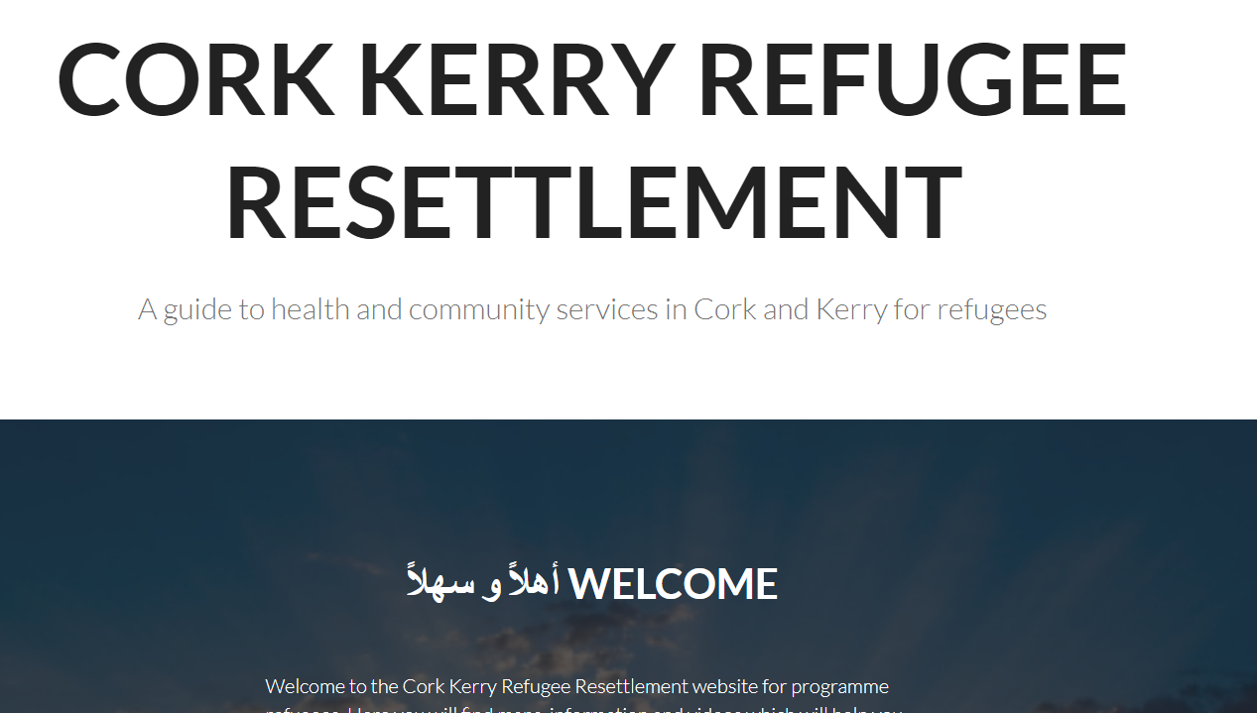
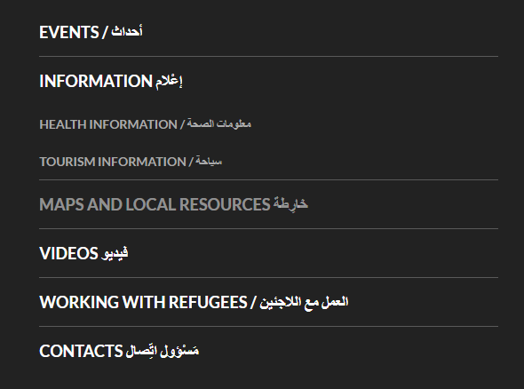
Website
Universal access
Online copy is more convenient than a hardcopy because it is easily updated and you can’t lose it.
Wider audience reach
Notes:
Website
People in migrant comm almost universally have access to smart phones and internet.
most of the information on the website, resettlement refugee will receive in a hard copy format. However if they lose these documents they might not easily get another copy.
The website means that people can access the information at any time, and is inclusive of a wider community of migrants as opposed to just settlement refugees.
Because its an online rather than hardcopy resource it can easily be updated. The website is compatible on desktop, phone, and tablet
Out of date
Lose hardcopies
Limited audience
Updatable easily – don’t need to send everyone new copies
Cant lose it
Cant be accessed by numerous groups

Slide 7
Maps
Notes:
Maps
The maps outline where health, community and general services are in the community and people can click on the map to find more information about specific services.
The map is simple to use, and we provide a short video showing people how to use it. This video has no words, just visual so language barriers are reduced.
The maps use a key as well, so community services are represented with different symbols, imagery and symbols are used often to increase recognition and reduce language barriers (Show how maps work, maybe use video)
Out of date
Complicated info
literacy
Easily but not automatically update
Complicated info like where educational, health, community services are, bus routes etc all available on one map than you can interact with.
Literacy, the maps use symbols and colours to be more easily accessed by people with literacy barriers.

Slide 8
Videos
Notes:
Videos
The videos aim to present very complicated information in a way that is easy to understand regardless of language barriers
The videos use bright clear images to clearly outline the information which is being explained. The videos are also available in both English and Arabic audio. So people who may not read Arabic can still benefit from the videos because they do not require someone to be able to read English or Arabic.
Complicated info
literacy
Visual presentation
Audio presentation
Making complicated info easy to understand and the videos also include timestamps so in a 10 minute video if someone is just interested in information on public transport they can click t that exact point on the video.

Slide 9
To conclude
You can use these resources in your own work
You can create this types of resources yourself
www.corkkerryresettlement.com
Email: maryclearychw@gmail.com

