Slide 1
Homeless and Hopeless Suicide, Self Harm and Homelessness: What might an adequate response look like?
Dr. Justin Brophy FRCPsych
Consultant Psychiatrist &
Clinical Advisor National Office for Suicide Prevention

Slide 2
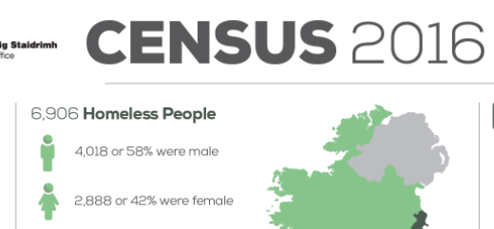
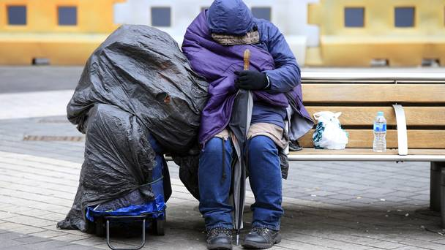
No. and distribution of homeless persons
Current figures for homeless are 8160
https://www.focusireland.ie/resource-hub/latest-figures-homelessness-ireland/

Slide 3
Homeless and suicide risk
The primary Problem is:

Slide 4
Homeless
......there are several problems

Slide 5
mental health and co morbidities in homeless persons
Homeless
Problem 1

Slide 6
Mental health services for homeless: patient profile and factors associated with suicide and homicide
Severe mental illness has a high prevalence
high levels of factors associated with suicide
Poor compliance and complexity of illness
a requirement for significant input from mental health teams
Ir Med J. 2012 Mar;105(3):71-2, 74.Dunne E¹, Duggan M, O'Mahony J. Homeless in Cork
O’Reilly F, Barror S, Hannigan A, Scriver S, Ruane L, MacFarlane A et al. Homelessness: An Unhealthy State. Health status, risk behaviours and service utilisation among homeless people in two Irish cities. Dublin: The Partnership for Health Equity, 2015.
Keogh C, O'Brien KK, Hoban A, O'Carroll A, Fahey T. Health and use of health services of people who are homeless and at risk of homelessness who receive free primary health care in Dublin. BMC Health Serv Res. 2015 Feb 12;15:58..
Public Health Resource Unit. Mental ill health in the adult single homeless population. A review of the literature. Crisis, 2009.

Slide 7
Self Harm
Homeless
Problem 2

Slide 8
Self Harm Registry - homeless rates 2006-11
In Ireland, 2006-11,
the risk of self-harm among people who are homeless
is 22 times higher compared to those with a fixed residence (4,165 vs. 186 per 100,000 population).
Minor tranquilizers / Alcohol
More lethality in Homeless
‘truly accurate information about rates and trends of self mutilation are difficult to come by because the majority conceal their activities’
http://www.nsrf.ie/wp-content/uploads/Briefings/Briefing%20Self-Harm%20and%20Suicide%20among%20Homeless%20People%2002-11-2014.pdf

Slide 9
Self Harm incidence 2015 Homeless V’s Population
In 2015, there were 576 self harm presentations by residents of homeless hostels and people of no fixed abode
http://www.nsrf.ie/wp-content/uploads/reports/NSRF%20Registry%20Report%202015.pdf
576 (Incidents) / 3625 (homeless No .Dept.Housing) = 15889 /100,000
crude estimate is several times higher incidence
of self harm compared to previously estimated
There were 527 presentations made by residents of homeless hostels and people of no fixed abode in 2016,
( NSRF 2017)

Slide 10
Homeless and Hopelesness
‘There’s no more I can do
I’m worn out, literally worn out’

Slide 11
Suicides
Homeless
Problem 3

Slide 12
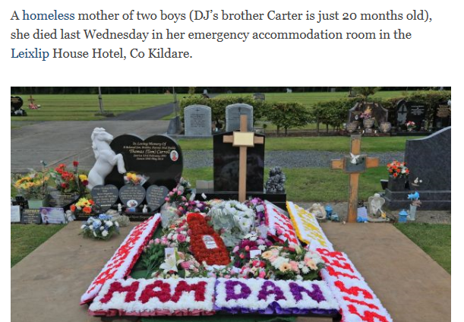
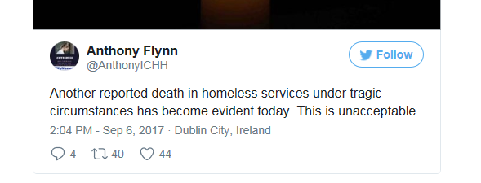
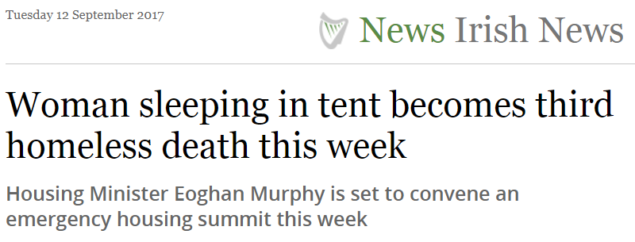
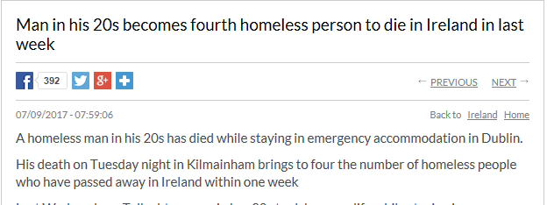
Not just Self Harm..... Suicide Deaths

Slide 13
Not just Self Harm..... Suicide
7-14 time higher rate in Homeless
Nielsen SF, Hjorthøj CR, Erlangsen A, Nordentoft M. Psychiatric disorders and mortality among people in homeless shelters in Denmark: Lancet. 2011 Jun 25;377(9784):2205-14. doi: 10.1016/S0140-6736(11)60747-2
UK suicides in homeless: 40 p/a 2004-14
= 3 p/a would be expected here
(index mundi population 2016 figures)
Extent of problem unknown here
‘unnatural deaths’ 26/10 yrs Dublin – Ivers and Barry 2016
Trend?
Changing risk groups
eg Families, Non-nationals, Fugitives

Slide 14
Homeless Families
Homeless
Problem 4

Slide 15
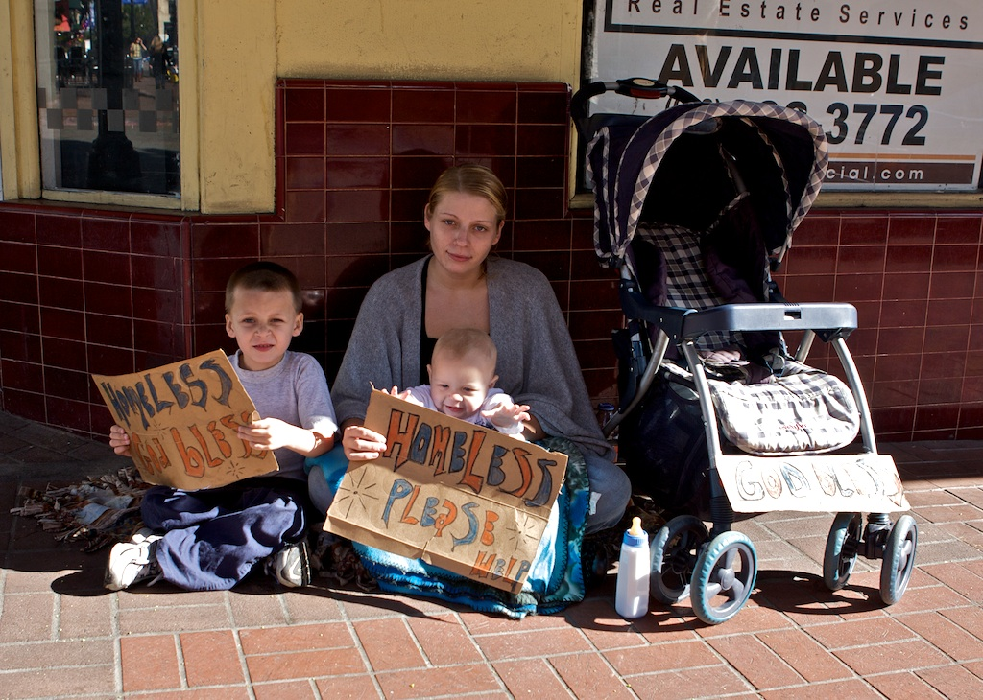
Homeless families
The most recent figures show there are now 1,429 families and 2,973 children homeless nationwide in Ireland. The number of families homeless has increased by 26% from July 2016 to July 2017.
The number of single-parent (usually mother-only) families with young children has increased at an alarming rate
https://johnnyvoid.files.wordpress.com/2013/02/homeless-family.jpg

Slide 16
Dr. Austin O’Carroll’s : Literature Review
Children of Homeless Mothers Homeless Mothers
33% display aggressive or delinquent behaviour.
50% experienced depression and/or anxiety.
20% pre-schoolers had experienced clinically significant emotional disturbance.
More than 75% do not receive adequate treatment.
have high rates of depression, post-traumatic stress disorder and co-morbid mental disorders.
affect mothers’ ability to effectively rear their children.
more likely to have problematic alcohol consumption
High rates of substance misuse
http://anew.ie/wp-content/uploads/2016/01/Young-Homeless-Mothers-and-Homeless-Children.pdf

Slide 17
Young People
Homeless
Problem 5

Slide 18
Homeless young people

Slide 19
Youth experiencing hhomelessness
In Ireland 2006-11, of homeless self harm
one fifth were aged 15-24
but at a lower rate compared to residents
http://www.nsrf.ie/wp-content/uploads/Briefings/Briefing%20Self-Harm%20and%20Suicide%20among%20Homeless%20People%2002-11-2014.pdf
In Ottawa, 43% of youth experiencing homelessness reported suicidal thoughts
46% in Toronto and Vancouver reported a past suicide attempt.
http://homelesshub.ca/about-homelessness/mental-health/depression-and-suicide

Slide 20
Homeless
responses

Slide 21
Vision for Change 2006
Adopt the principle of community-based care
The responsibility devolves without ambiguity to CMHT
Designation of a CMHT with responsibility for the homeless in each catchment area -
the service modality assertive outreach
Two specialist multidisciplinary, community-based teams should be provided to the homeless population
Crisis House

Slide 22
Outreach and access to services
Mental Health - Canada
“But even the best outreach efforts cannot be successful without following through and offering proper programs and services” There is always a need for better access to and a larger number of healthcare services for people experiencing mental illness.
People experiencing mental illness need
more services in hospitals,
more beds in acute care hospitals and provincial facilities,
more community based programs and services,
more supports for people to be independent and employed in their communities,
more outreach, outpatient and rehabilitation programs,
more awareness programs,
more housing with supports for people with mental illness,
more coordination of services, more support for families,
more crisis intervention
and more mental healthcare providers.
http://homelesshub.ca/about-homelessness/service-provision/outreach-and-access-services-mental-health

Slide 23
Homeless
Barriers & gaps
‘Fuck the hospitals’

Slide 24
Dublin specialist homeless services
Homeless patients, not in their services
‘may present to general Mental Health Services during the working week,
but especially out-of-hours, in crisis,
referred by health or social care services or by self’.

Slide 25
“Red tape and stigma are barriers to homeless seeking mental health services”
‘Homeless people with mental health difficulties looking for help are being doubly hampered by a double whammy of their vulnerable state and bureaucracy.
A new report from Mental Health Reform and the Dublin Simon Community’
Difficulties getting access to mental health services
Catchment area question
Gardai or hospital services refuse to take in service users who express suicidal behaviour
if they have an active substance in them
due to the Mental Health Act,
creating difficulty for workers trying to provide support.
Mistrust and negative experience

Slide 26
‘Enough is enough’

Slide 27
Homeless exclusion?
More than three times the number of NFA inpatients in 2016 than in 2013 (HRB)
Despite a 29.2% drop in inpatient beds 2006-15,
a 14% drop since 2010
Out of hours access an issue for all
ED wait times are problematic for all
10-30% further hospital beds lost through delayed discharges

Slide 28
Homeless
Options & recommendations

Slide 29
Goal 3: Focus on priority groups
To target approaches to reduce suicidal behaviour and improve mental health among priority groups

Slide 30
Identified Sector requirements
In reach
Prevention
Crisis – but not ED
Non Discrimination
Compassion
Trauma Informed Care
‘No wrong Door’
Access to MHS
Community
7/7 – 24/7
Policy review
Scale
Co-Production
Crisis Sanctuary
Broader skill base
Intoxication -Distress?

Slide 31
Primary Care Options
Options

Slide 32
Counselling Service - Primary Care
.
Dublin Simon Community established the Sure Steps Counselling service.
This offers one-to-one counselling, drop-in clinics, emotional wellbeing groups
and an on-demand crisis intervention for people who are in distress or feeling suicidal.
"The main success of this service is that counselling and support goes to where our clients are staying, with flexible session times and lengths.
“but one service and is a drop in the ocean”

Slide 33
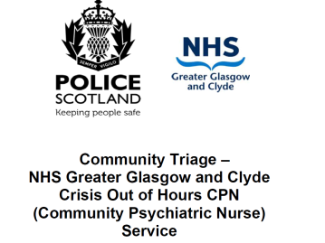
Primary Care In Reach Service
Glasgow Community Triage Service
The Community Triage Pilot has demonstrated that the vast majority of related
incidents, occurring out of hours are satisfactorily dealt with and concluded by a
telephone consultation between the individual concerned and a CPN, thus
removing the need on these occasions for the police to take them to hospital.

Slide 34
SCAN in Primary Care
“It would be a welcome step to provide SCAN specifically to liaise with homeless services”
ANP in MH Nursing to Homeless.
‘
+ Reduce self harm,
prevent crisis and support providers,
reduce ED burden
- GP referral
Linkage to Primary Care surgeries
Out of hours capacity
Integration with CMHT’s
The Suicide Scan Assessment Nurse service is due to be rolled out in the following areas by the end of 2014: Dublin North + , Dublin South Central X, Cork North Lee etc’

Slide 35
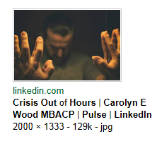
CRISIS CAFE
e.g Safe Haven Aldershot, Big Life Manchester
offer diversion away from A&E services
(which can sometimes precipitate a worsening of circumstances).
Read more
https://www.linkedin.com/pulse/crisis-out-hours-carolyn-e-wood-mbacp

Slide 36
Big Life Company in Greater Manchester
Run an out of hours Peer Supported Sanctuary as an alternative to A&E
Self refer or be directed there by police, GP, ambulance, A&E etc
could be diverted there from A&E
can access medical care if needed.
staffed by people with lived experience of suicidal behaviour”
and trained to deal with a person at any point along the spectrum of crisis
The charity also have Peer Supporters sat in A&E supporting those waiting
reducing the number who leave after triage.

Slide 37
Strengthen Self Harm Programme
A Randomized Controlled Trial of Post-crisis Suicide Prevention
Jerome A. Motto, M.D., and Alan G. Bostrom, Ph.D. June 01, 2001
Post ED Outreach
A systematic program of contact with persons who are at risk of suicide and who refuse to remain in the health care system
appears to exert a significant preventive influence for at least two years.
Specialist Post ED Outreach for homeless?

Slide 38
Specialist Care Options

Slide 39
Strengthen existing Homeless Teams
"The solution is to develop and deliver a 24-hour seven day a week direct access community mental health service
for homeless people already engaged in the mental health services,“
Homeless Adults Speak Out on Mental Health group
https://www.mentalhealthreform.ie/wp-content/uploads/2017/06/Homelessness-and-mental-health-report.pdf
http://www.thejournal.ie/homelessness-mental-health-services-3445183-Jun2017/

Slide 40
Strengthen existing CMHT’s
Community Mental Health Nurse – Adult Homeless Waterford
The Community Mental Health Nurse (CMHN) Homelessness post was established in 2006 as a designated post
to address the gaps
more positive working relationship
to advocate
to facilitate effective management of admissions and discharges
Promote positive mental health
Referral –Through Waterford Homeless Action Teams,
Direct referrals from voluntary and statutory organisations.

Slide 41
Strengthen Existing Teams / Services
‘Overnight Psychiatric Crisis Service – Glasgow
Nurse led
‘Distress Brief Intervention Programme- Scotland’
Add dual diagnosis capacity
Not provided for in CMHT’s
Clinical care programme planned
‘Lost competency’
Will require specialist inpatient and rehab assets
HSE CCP Programme just starting

Slide 42
Homeless families
https://johnnyvoid.files.wordpress.com/2013/02/homeless-family.jpg

Slide 43
Children of homeless mothers 2001
http://www.drugsandalcohol.ie/5191/1/Children_of_homeless_mothers.pdf

Slide 44
Homeless young people
http://www.southeastradio.ie/2017/09/anger-as-taoiseach-tweets-about-dianas-death-while-homeless-die-on-the-streets/

Slide 45
Homeless youth & young adults
Specialist CAMHS function?
Other? Eg NGO?

Slide 46
Commitments 2016
HSE Service Plan for 2016 in-reach services are provided to emergency accommodation settings
Additional funding of €2m for the provision of case management for chronic and enduring health needs, in collaboration with mental health services.
This will be increased to €6m next year (’17) for appropriate Pathfinder projects
In addition, there will also be a particular emphasis on significant projects providing drug and alcohol detoxification programmes
and enduring services supporting long-term recovery.
http://rebuildingireland.ie/install/wp-content/uploads/2016/07/Rebuilding-Ireland_Action-Plan.pdf
Helen McEntee, Minister of State for Mental Health, said
A key priority of the HSE's National Service Plan is the provision of
Out-of-hours liaison and seven day responses

Slide 47
In Conclusion

Slide 48
Service development models
SCAN –
+ Safety Net?
Cafe/Sanctuary
+ Sure Steps?
Strengthen existing MHS
Community triage
Overnight or additional beds?
Dual Dx
DBI
Strengthen existing Homeless teams
24-hour seven day a week direct access?
Strengthen Self Harm Programme
Prioritise Homeless in Self Harm programme?
Protocols re intoxication across sector?
Systematic contact post ED
Specialised Family Outreach
Youth Specific Focus
Provider?

Slide 49
MH services in isolation
Clearly
Multiple additional inputs are also needed
not provided by mental health or primary care health services
Addiction services
Legal changes? - Counterproductive?

Slide 50
Thank You

Slide 51
References
https://www.hse.ie/eng/services/Publications/Mentalhealth/housingdocument.pdf
https://www.irishpsychiatry.ie/wp-content/uploads/2017/04/AMMENDED-Position-Paper-of-College-of-Psychiatry-of-Ireland-on-the-Specialist-Mental-Health-Services-for-Homeless-People-Copy-Copy.pdf
https://www.linkedin.com/pulse/crisis-out-hours-carolyn-e-wood-mbacp

