Slide 1
Homeless drug users’ recent experiences of therapeutic communities as the basis for improving service provision
Mark Kennedy FCCA, MSc, Hdip
Head of Residential Services, Merchants Quay Ireland

Slide 2
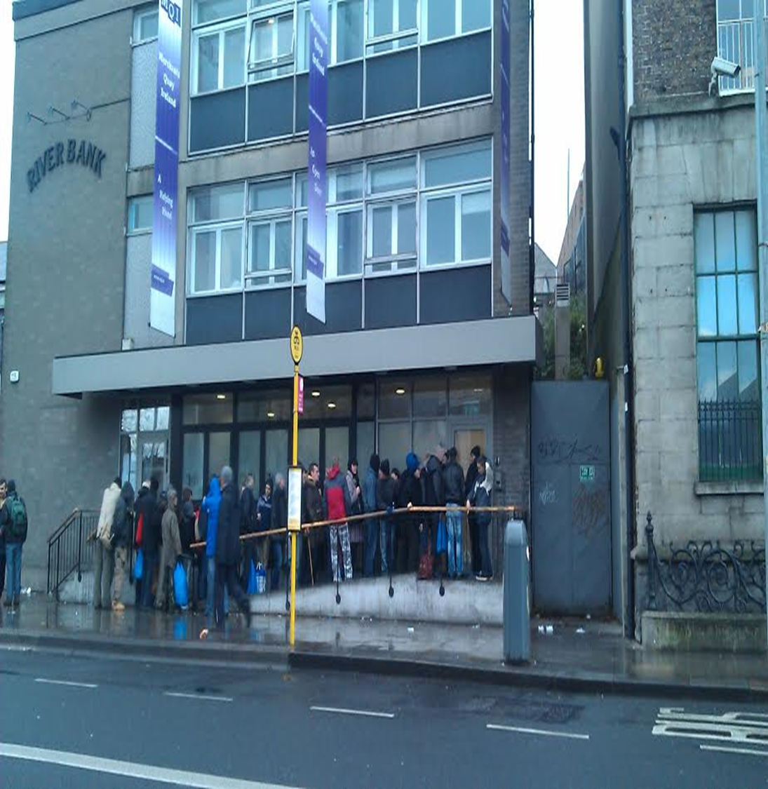
Objectives
  Lived experience
  Triangulate with professionals
  Explore recent & potential changes
  Recommendations

Slide 3

Irish TC Origins
13 TCs in Ireland (EMCDDA, 2014)
The Irish TC experience
Lawless & Corr, 2005 – entry criteria, individualised goal setting, waiting times, inflexibility and high demands
Longitudinal study (Harris & Babinau 2015)
Program retention
Modified TC’s(De Leon, 2000).
TC housing supports (Sacks et al., 2003)
Notes:
TC origins
Right living
Community as method
Therapeutic fundamentalism
European TC concept fidelity
‘modified therapeutic communities’ (MTC’s)
The Irish TC experience
one of the "most dangerous and violent cults America had ever seen."

Slide 4
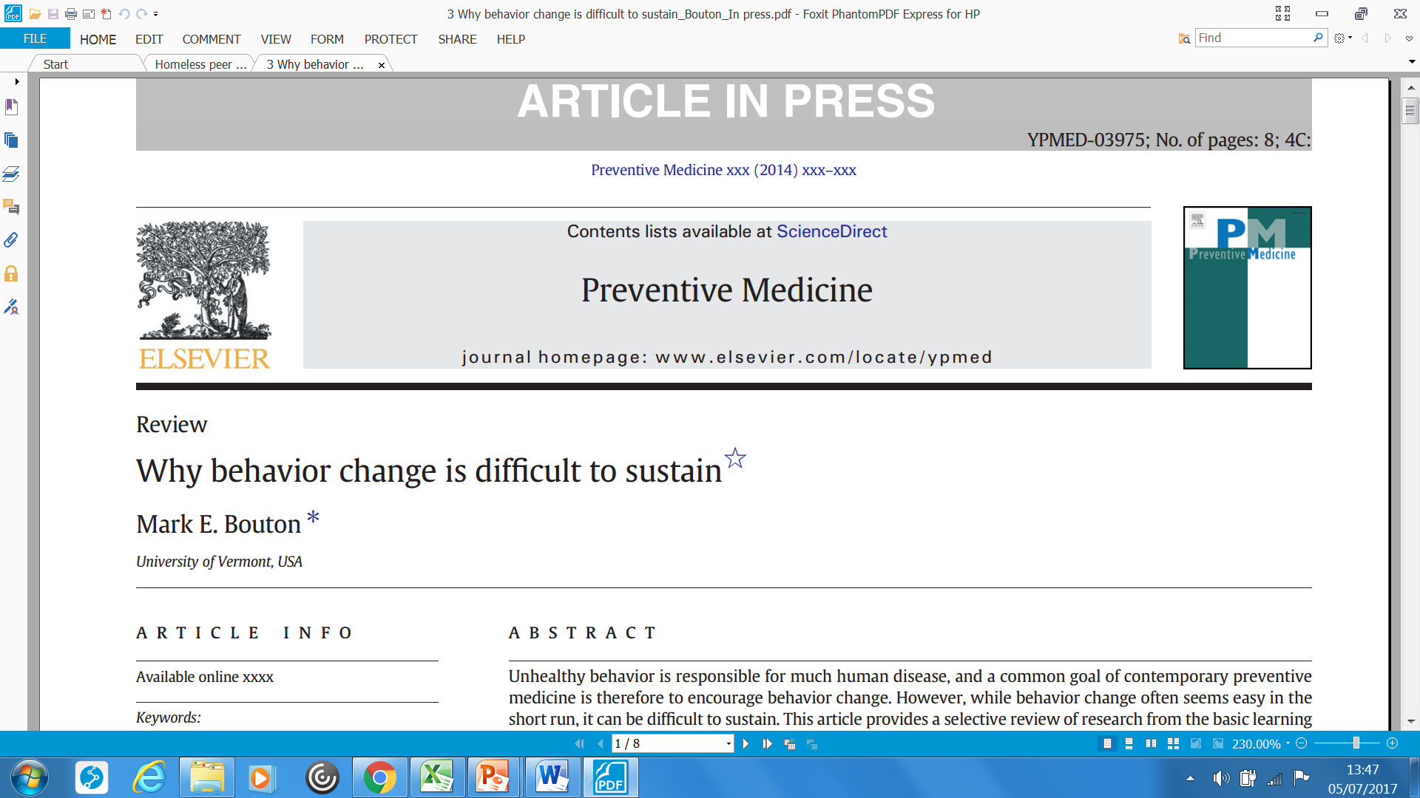

Slide 5
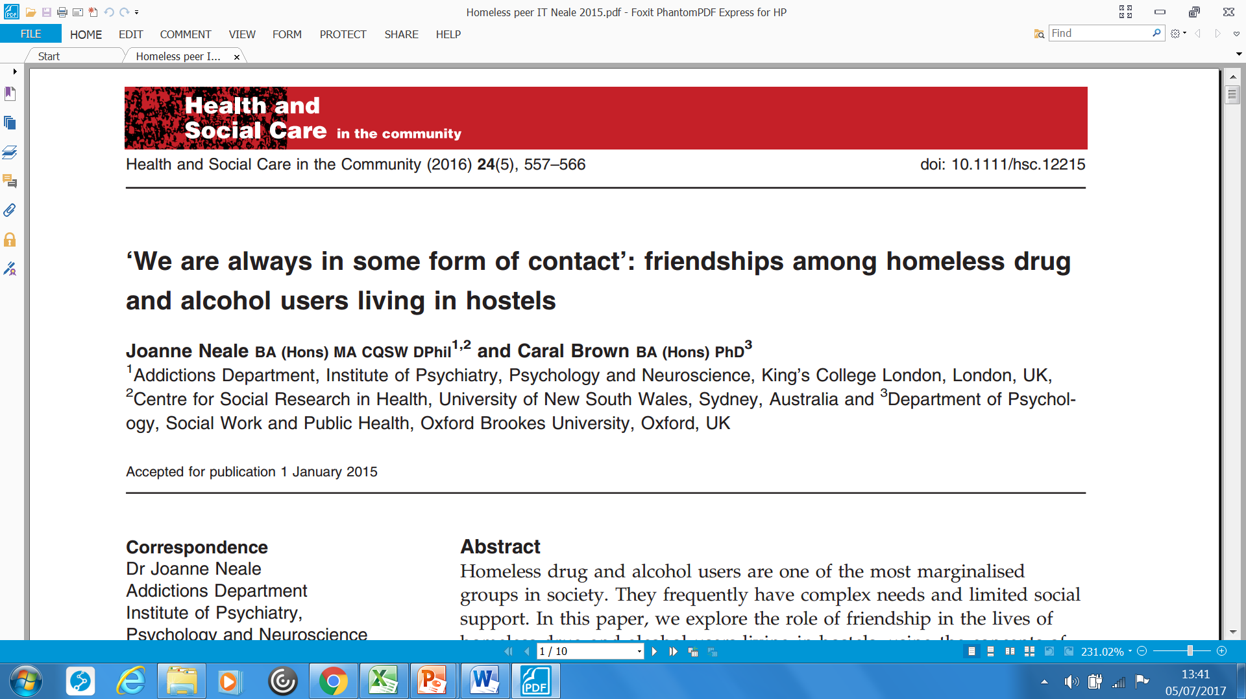

Slide 6

Methodology
11 semi structured interviews.
5 clients & Drug users Forum
Clinical Nurse Manager (CNM)
Psychiatric nurse
Doctor
Psychotherapist
TC CEO
Insider status
Thematic analysis

Slide 7
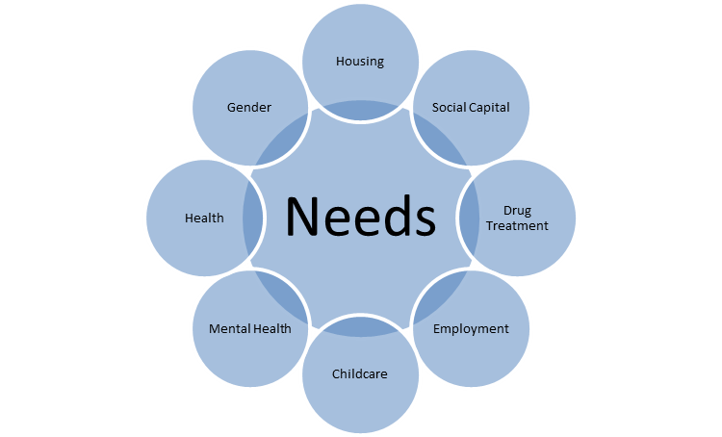
Overlapping
Top of spectrum
Against the odds

Slide 8
Pre entry experiences

Slide 9
Pre entry experiences
doing elements of maybe the work they would get in the residential setting before they go in, and that's just to get them to the stage where they can go in but you're doing it in the chaos and in the hostels and wherever they are. (psychiatric nurse)

Slide 10
TC experiences

Slide 11
Post TC experiences

Slide 12
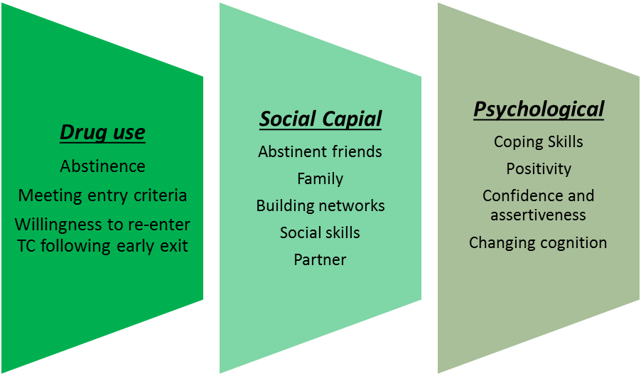
Positive outcomes

Slide 13
…retention underlying outcome
………… Like me walking out of the treatment centre wasn't an option. I could walk out any day like, but why would I? ….to walk around, sit on the street like..? (client 02, male)

Slide 14
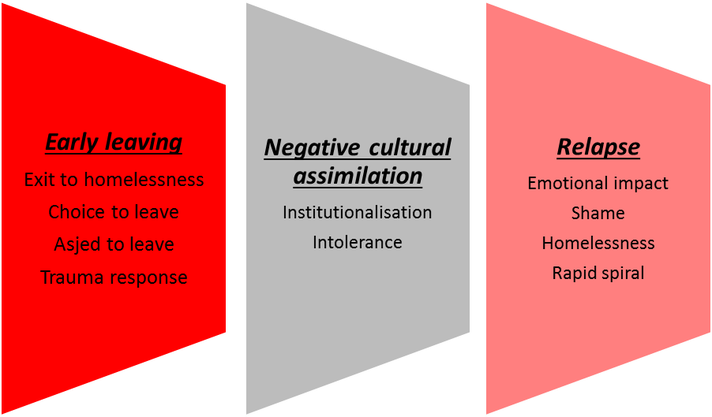
Negative outcomes

Slide 15
…shame arising out of relapse
…………I had a young guy and he went into one of these programmes and he was ashamed to come back when he had a slip. So he spend about 3 months living in a car so that’s not a very good thing for anybody.. (Doctor)

Slide 16
Building Social Capital through ICT

Slide 17
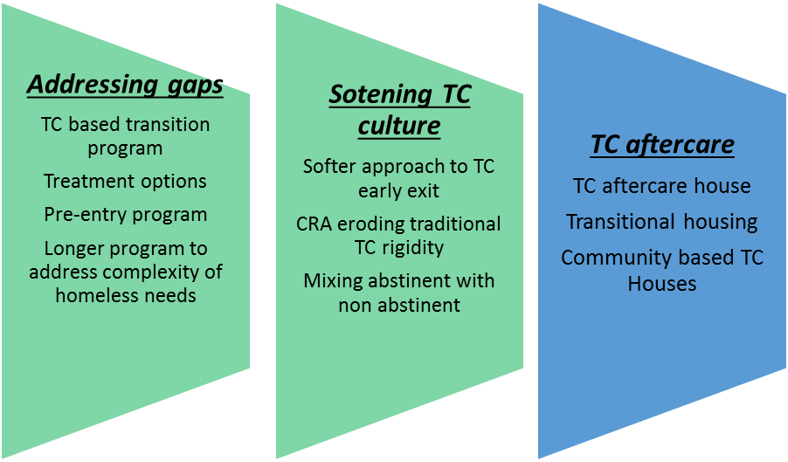
Perceived changes in Irish TCs

Slide 18
Potential changes

Slide 19
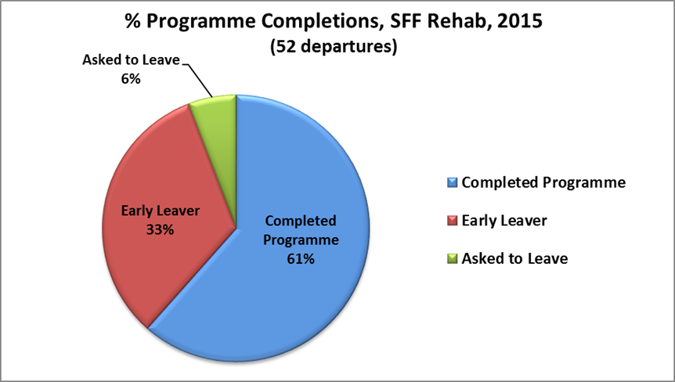
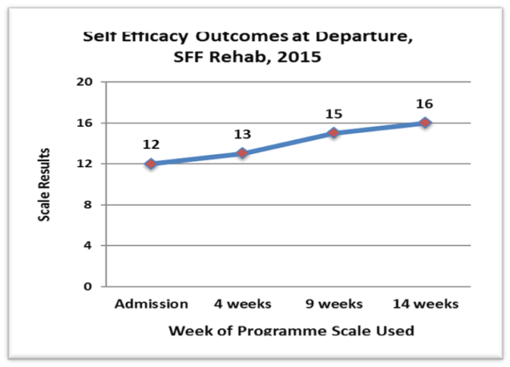
Who defines quality?
it’s almost heart breaking in that we are not allowing people the right to qualify what quality is, what quality means to them. The measurable outcomes need to be set against the individual not the service. (Drug users forum)

Slide 20
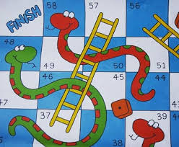

Slide 21

empowerment
mitigate risks

Slide 22
Reframing relapse as an event rather than a change in identity

Slide 23


Slide 24

'unconditional love' at key points

