Slide 1
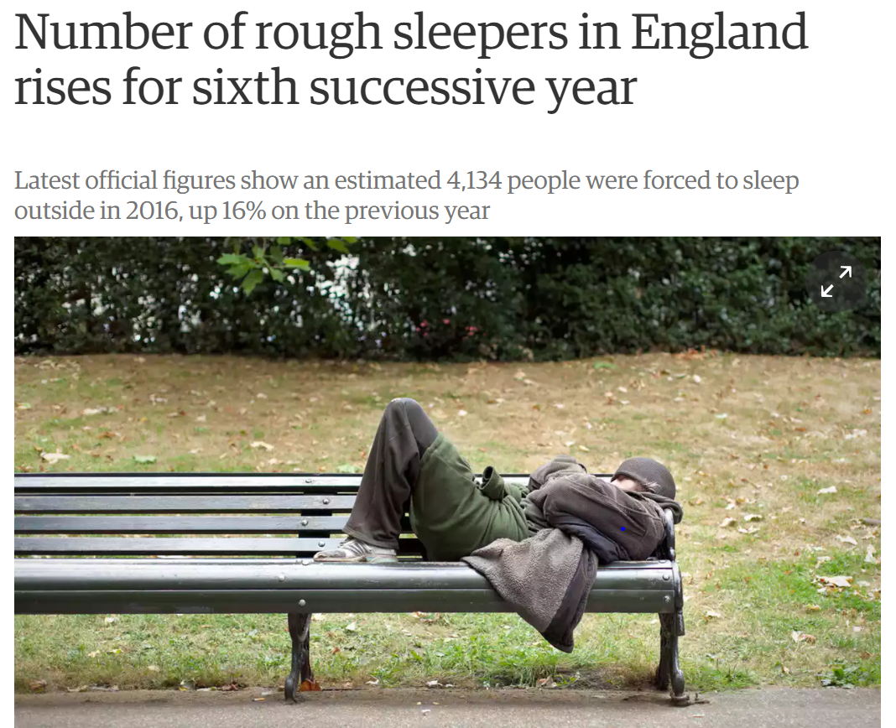

Slide 2
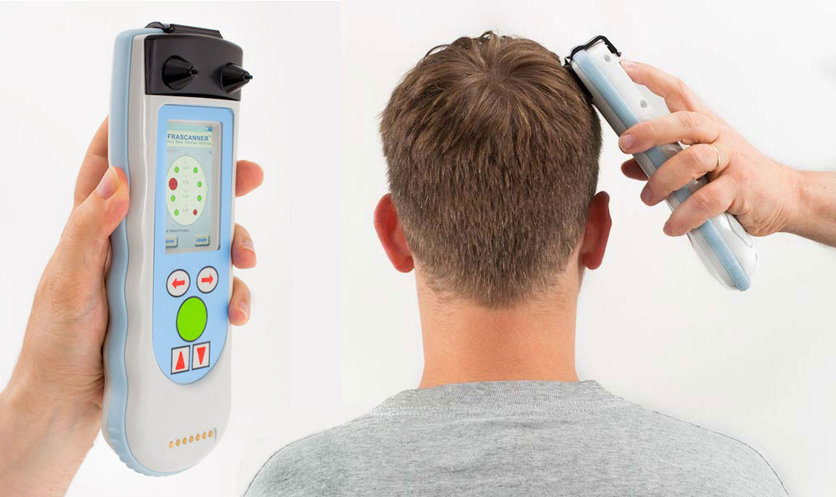

Do they Deserve?
DESERVOMETER®
Find out Now
Point of care eligibility testing for all your clients

Slide 3
A systematic review and meta-analysis of morbidity and mortality data from homeless, prison, sex work and substance use disorder populations in high-income countries
Dr Al Story

Slide 4

The health impact of exclusion

Slide 5
Summary of methods
We identified studies that have measured rates of death and disease in four marginalised groups: homeless people, people who use drugs, sex workers and prisoners
We described the frequency of a range of diseases using ICD10 classification
A subset of studies compared the rate of death to age-matched people from the general population
  pooled subset results - summary indicators for men and women

Slide 6
7,946 articles identified 2005–2015
1,274 duplicate articles excluded
711 full text articles first review
337 studies full review
3,219 data points* extracted
2,835 included after removal of duplicates
*an effect estimate for a unique population

Slide 7
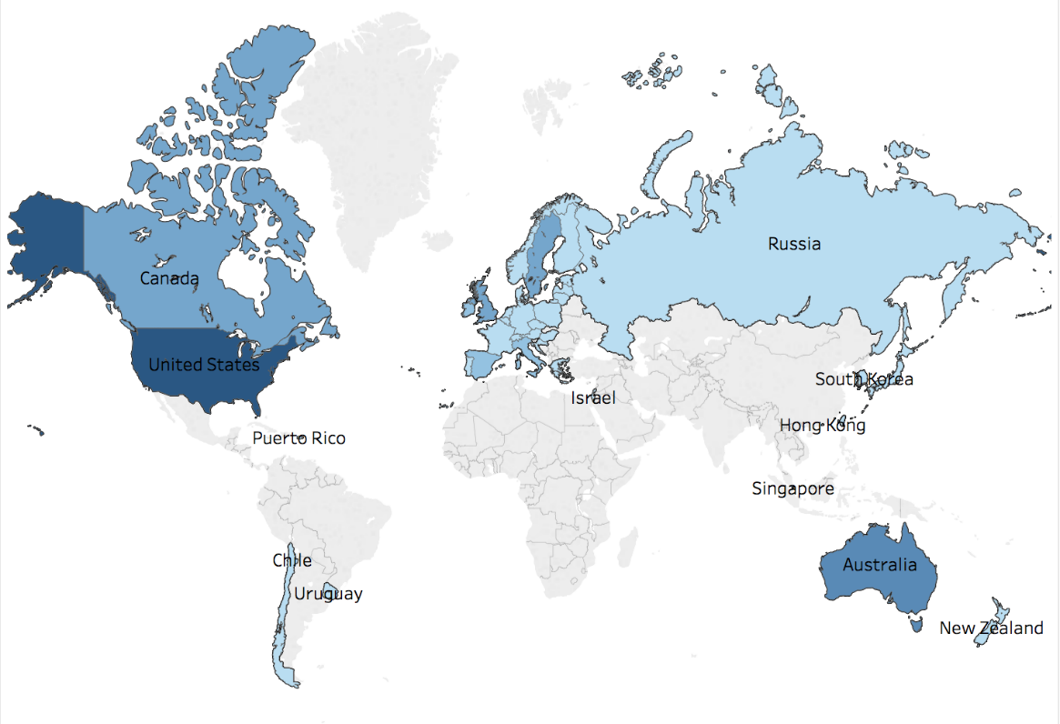
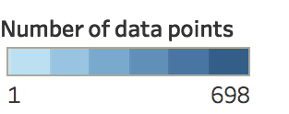

Slide 8
Box size indicates number of data points included (e.g. Infectious and parasitic disease = 953; Disease of Nervous system = 43)

Slide 9
Summary SMR estimates for ICD-10 categories
Injury, poisoning
  Males 7.9 (95% CI 6.4-9.4; I² 98.1%)
  Females 18.7 (95% CI 13.7-23.7; I² 91.5%)
External causes
  Males 6.5 (95% CI 5.5-7.5; I² 97.4)
  Females 13.1 (95% CI 9.9-16.4; I² 93.0)
Infectious and parasitic diseases
  Males 2.8 (95% CI 1.6-4.1; I² 65.4%)
  Females 5.6 (95% CI 1.5-9.7; I² 60.0%)

Slide 10
Summary SMR estimates for ICD-10 categories
Neoplasms
  Males 1.6 (95% CI 1.3-1.9; I2 88.7%)
  females 1.9 (95% CI 1.3-2.5; I2 62.8%)
Diseases of the circulatory system
  Males 2.4 (95% CI 1.5-3.4; I2 94.5%)
  Females 3.1 (95% CI 1.8-4.5; I2 51.5%)

Slide 11
Mental and behavioural disorders
Pooled prevalence estimates (homeless)
major depression 11.4% (95% CI 8.4-14.4%)
personality disorder 23.1% (95% CI 15.5-30.8%)
alcohol dependence 37.9% (95% CI 27.8-48.9%)
drug dependence 24.4% (95% CI 13.2-35.6%)
psychotic illness 12.7% (95% CI 10.2-15.2%)

Slide 12


Women
Men
Standardised mortality ratios for deprivation groups in England*, IMD1 – IMD10 (1 = expected rate of death)
IMD
*Deaths by underlying cause, deprivation decile areas, 5 year age groups and sex, England and Wales, 1981 to 2015 Populations by deprivation decile areas, 5 year age groups and sex, England and Wales, 2001 to 2015

Slide 13
Mortality rates for those aged 15–64 in the most deprived areas of England and Wales compared to least deprived areas
  2.8 times the rate for men
  2.1 times the rate for women

Slide 14

Slope Index of Inequality (SII)

Slide 15
Health Inequality
Differences, variations, and disparities in the health achievements of individuals and groups of people
Braveman, P.A., Monitoring equity in health and healthcare: a conceptual framework. Journal of health, population, and nutrition, 2003. 21(3): p. 181.

Slide 16
Women 11.9 (95% CI 10.4–13.3; I² 94,1%)
Men 7.9 (95% CI 7.0–8.7; I² 99.1%)
IMD

Slide 17
Women 12 (95% CI 10.4–13.3; I² 94,1%)
Men 8 (95% CI 7.0–8.7; I² 99.1%)
IMD

Slide 18
Cliff edge of Inequity (CEI)

Slide 19
Health Inequity
A difference in health outcomes that is systematic, avoidable, and unjust
Braveman, P.A., Monitoring equity in health and healthcare: a conceptual framework. Journal of health, population, and nutrition, 2003. 21(3): p. 181.

Slide 20
Conclusion
Extremely high SMRs across ICD-10 categories
Relative risks consistently higher in females
Relative mortality excess greatest for injury, poisoning and external causes

Slide 21
Conclusion
Higher relative mortality across more common disease categories = high ‘preventable’ excess deaths (CVD, Cancer, Resp)

Slide 22
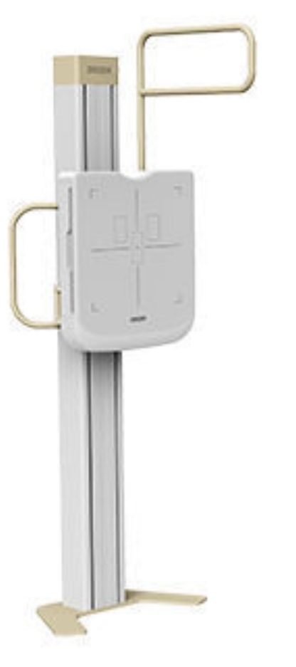
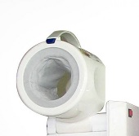
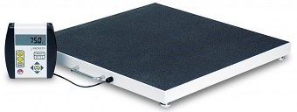
Need greater focus on prevention and management of more common conditions

Slide 23
Conclusion
Consent - Linkage ➔ Our job
Life-course
Missed Multiple Morbidity

Slide 24
Conclusion
Stop saying ‘Inequality’…it’s ‘Inequity’
It could happen to anyone

Slide 25
