Slide 1

What’s good for the patient is also good for the hospital:
Pilot of an Inclusion Health Service, SJH
Clíona Ní Cheallaigh
Inclusion Health Service
St James’s Hospital
Dublin
Notes:
Thanks, I want to talk about something that I think is at the heart of what SJH is about.

Slide 2
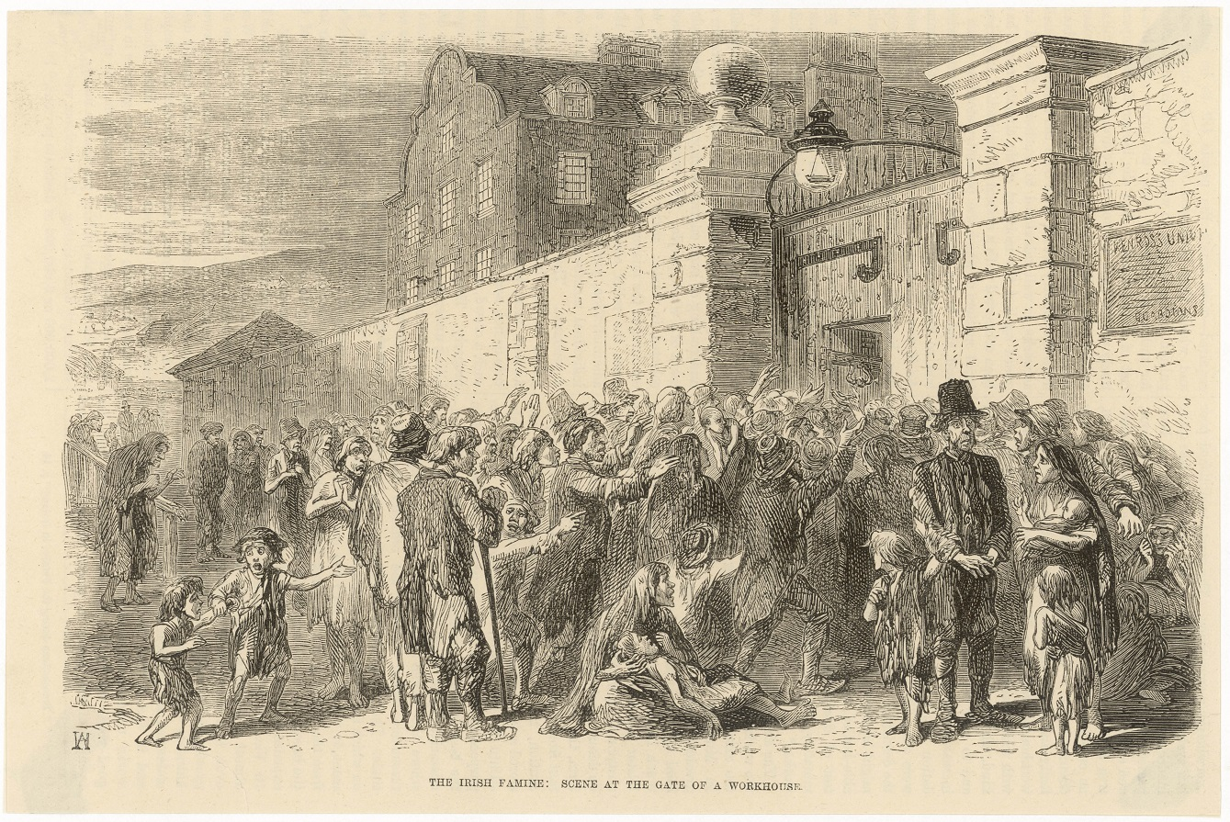
St James’s Hospital 2015

Slide 3

The gap

Slide 4
Notes:
Homeless numbers
New hostels – warehouses, non mobility accessible, out during day
Addiction support
AMAs
DNAs
Readmissions
Specials
Lack of trust – eg De Paul
DRHE interaction
No access to convalescence

Slide 8

The landscape

Slide 10
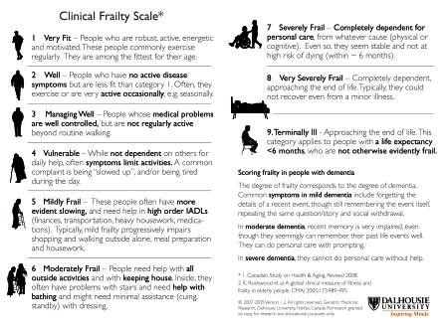
55% scored 4 or higher

Slide 13
Inclusion Health Service Pilot: July –Dec 2016

Slide 14
What is Inclusion Health (x3)

Slide 15
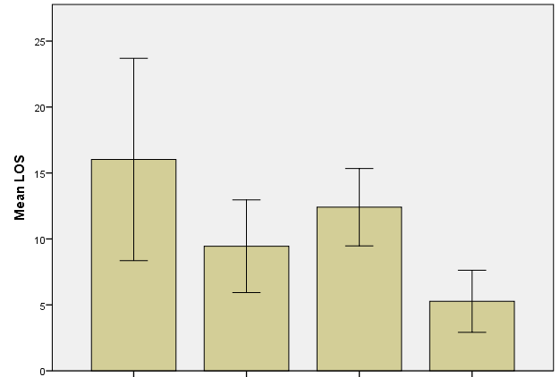

Slide 18
Savings
153 admissions
2002-2720 bed days (prevented admissions and reduced LOS for admissions that occurred)
  500,000+ euros (standard bed day cost)
7000+ hours of 1:1 special
  300,000+ euros

Slide 19
The ingredients: (re-)admission avoidance
  Registration in Dublin
  Advocacy via MQI keyworkers for 24 hour access/rolling bed
  GP - Safetynet
  Medications
  Education of hostel staff re what to call ambulance for/other avenues for assessment
  Communication re discharges (e.g. what not to worry/call an ambulance for)
  Outpatient management where possible
  Psychologically informed approach

Slide 20
Future Plans
Permanent (and larger) team
Dissemination of approach within SJH and other hospitals
MORE (and more suitable) accommodation
    Accessibilty
    24 hour access
    Support – cognitive improvement
Interface with DRHE
Pathway for diagnosis of dementia, assessment and LTC
Assertive outpatient engagement
Education –eg re DSH
Intermediate care (step-up, step-down)

Slide 21
Thank you!

