Slide 1
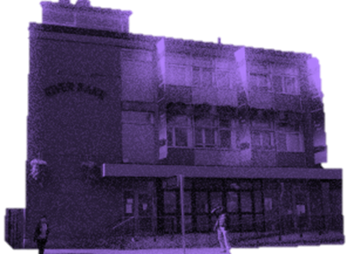
The Night Café
Sept. 2017
Why do clients repeatedly return to the Night Café?
Amy Lamont
Brenda Kane

Slide 2
Initial Analysis:
Safety
Feeling of belonging within Service
“This is it” i.e. Clients do not see progression routes
Staff Levels & Ethos
The Night Café, meets the basic needs of clients. However, through engagement this service promotes pathways to primary health care services & harm reduction specific interventions.
The feeling of safety within the Night Café leads to a sense of belonging within the service with clients reporting not being able to see progression routes; the feeling of ‘This is it’.
In keeping with the housing first approach; when an individual feels safe they can then begin to focus on other areas of their lives, areas which may have been long neglected, including the treatment of chronic health problems, or simply to recover from ‘the extreme stress of street life’ (Tsemberis, 2010; pg. 44).
The interactions and engagements between staff & clients, and their subsequent relationship is the “most important feature” influencing the service ethos, and subsequent service model (Johnsen, et. al., 2005)
What is conducive to a Safe Environment? - Levels of staffing & staff ethos
The interactions and engagements between staff & clients, and their subsequent relationship is the “most important feature” influencing the service ethos, and subsequent service model (Johnsen, et. al., 2005)

