Slide 2
WG 5: Utilising Ireland’s 1st Mobile Health and Screening Unit to best effect
Friday 28th September
Dr Bridget Kiely & Dr Mark O’Loughlin
Notes:
We introduced MHSU, highlighted some work from Galway and TB in the East, and did a prioritisation exercise – basically what should the MHSU do next

Slide 3
Dr Margaret Fitzgerald
Notes:
HSE remit
Highlighted 0.96% of health budget
Relies on Section 39 agencies
26% increase in asylum seekers
Hep C opportunity- find and treat
Social Dterminants
Harm reduction opportunity- engagement

Slide 4
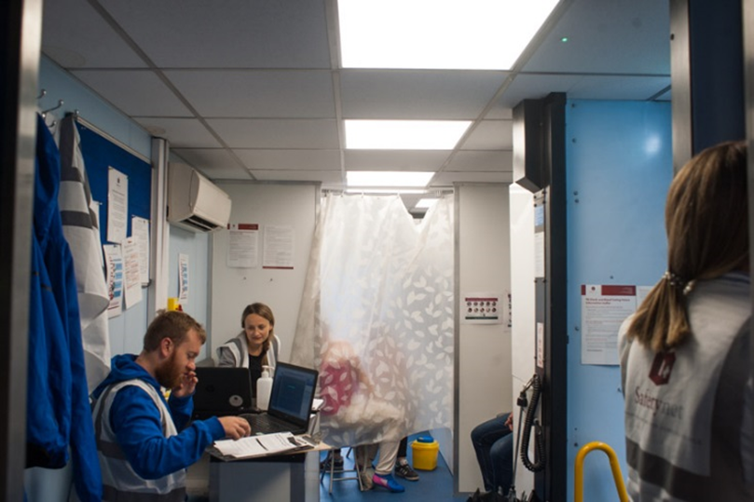
Safetynet & HSE | Statutory and voluntary sector partnership
The Mobile Health & Screening Unit
Safetynet’s Mobile Health and Screening Unit (MHSU) is a new service provided by Safetynet Primary Care in partnership with HSE Social Inclusion. The MHSU provides the following services when there is an identified need among a vulnerable group not accessing health care services:
Health screening and medical assessments for relocated refugees.
Communicable disease screening including TB, Blood Borne Viruses, STIs for groups at risk.
Clinical assessments and prioritisation as part of healthcare needs analyses for response and service planning
The Mobile Health and Screen Unit (MHSU) is a health team (GP, Nurses, Project Manager and Driver) working from a mobile clinic equipped with an X-ray and consultation room.
Notes:
Started in March 2017, responded to a call from Social Inclusion
Our approach is to work with local services and service managers to meet gaps, and facilitate integration into routine primary care services
700 Syrian refugees health assessment – similar health problems to gen population- language, specific mental heath needs, dental health. Homeless infectious disease screening- identified cases of TB- suggest that rate TB are ten times higher than general population- Al lStory craic and TB relationship, Hep C – now have new treatment, Increase in asylum seekers opening new DPC- assessments provide evidence for additional services- eg lisdoonvarna

Slide 5
Notes:
Flexibility, mobility, integration, gathering data- evidence for action, working with others hugely important- especially here we don’t have a footprint

Slide 6
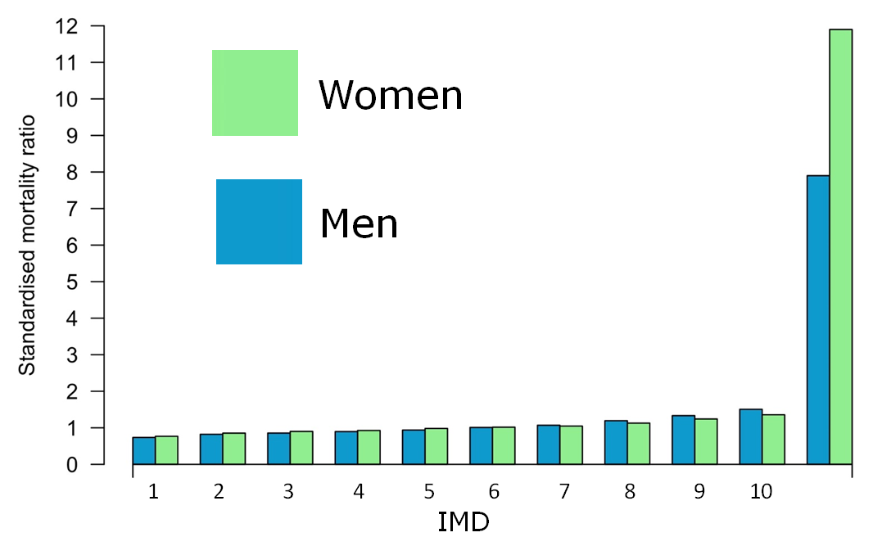
Notes:
One example TB screening in Galway, ran concurrently with homeless health survey- cxr was a big draw. Highlight the mortality inequity cliff

Slide 7
Screening
Galway
15-16 January 2018
31 people seen
24 X-rays
18 bloods
20 February 2018
22 people seen
21 X-rays
8 bloods
Ballinasloe
19 February 2018
23 people seen
20 X-rays
11 bloods
Galway
10 July 2018
41 people seen
40 X-rays
23 bloods
17 Urines
Notes:
Several visits, numbers seen

Slide 8
Screening results
Galway
15-16 January 2018
1 previously known HCV
20 February 2018
1 previously known HBV
1 possible new HCV
1 referred to TB clinic
Ballinasloe
19 February 2018
No abnormality detected
Galway
10 July 2018
1 old TB
Rib fractures – repeat CXR
1 weak pos syphilis
1 resolved HBV and HCV
Notes:
Results- HCV even if prev known – new opportunity to link in with services and treatment

Slide 9
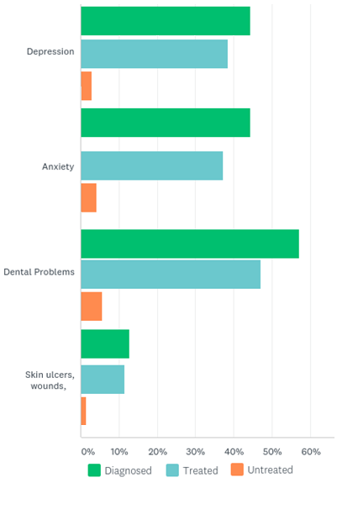
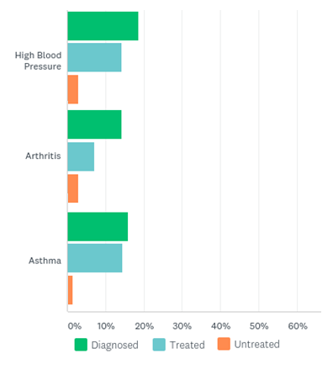
Results: Survey
Impact of health issues
Notes:
Same burden as generaloppulaiton pus mental health burden, lots of other findings from that survey, snapshot

Slide 10
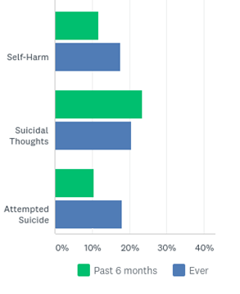
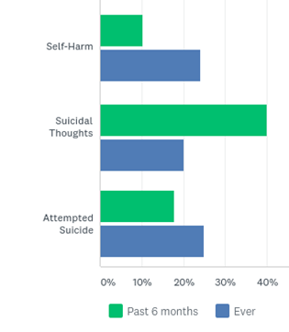
Results: Survey
Impact of mental health issues
Winter
Summer
Notes:
? Sample bias – Males very high in proportion in summer. Very big impsct of this on day to day lives

Slide 11
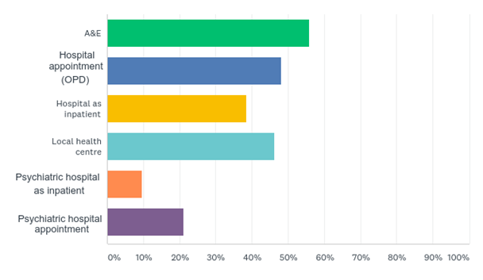
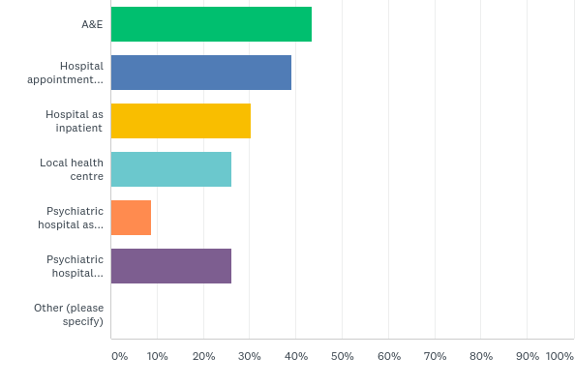
Results: Survey
Health service utilisation (past 6 months)
Notes:
Barriers of access- means a lot of ED usage, also high health burden

Slide 12
A lesson from the past
Notes:
TB in Ireland- low incidence country, but now focused in at risk groups, also risks MDR eastern European popualtions. Slide shows risk of comaplacency from US program. Animal program has 60 million funding- none specifically dedicated to human TB. HCWs outbreak isoniazid TB

Slide 13
Priorities for marginalised groups in your field
Mental Health needs
Access- Language barriers especially
Potential for use of peer workers
Increase in PWID in Derry- 246% increase
Entrenched chronic homeless- need more data on dual diagnosis
Prisoners especially those marginalised due to serious crimes
Trauma in children of homeless families
Notes:
Got feedback from our diverse range of participants- anthropologists, people from Northren Ireland, doctors, nurses, researchers

Slide 14
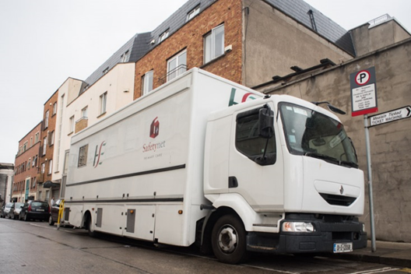
What areas can the MHSU focus on?
Pathways to integration and accessibility 7
Women's Health 5
Prisoner TB screening and follow up 5
Dual diagnosis and mental health 5
Naloxone 5
Language 4
Peer workers 4
Data 3
Undocumented migrants 3
Geography/Rurally isolated 3
Resource capacity building and staff development 3
Notes:
Some themes run throughout all areas- resoursce builing and keep doing what you are doing!!

Slide 15
Keep doing what you are doing!!!!!

Slide 16
Suggestions on how to work best together
Seminars with relevant groups
Contact sharing
Forum on website to share best practice and send suggestions for MHSU
Service user involvement
Local Community engagement
Social Inclusion Forum
Cross border collaboration
Notes:
No to whatsapp or ther social media. In no particular order

Slide 17
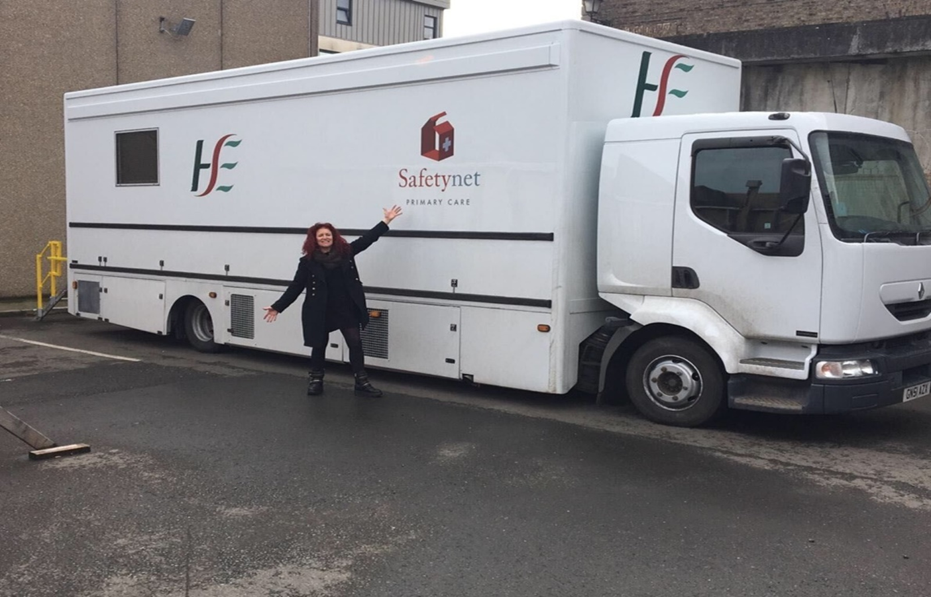
Permanent funding for the MHSU- particular focus on TB control!

