Slide 1
Moving Towards Trauma Informed Care: A Model of Research and Practice
Graham Gill-Emerson
Notes:
Here today to talk to you all about a project that we at CSC have been working on in conjunction with UCC and HSE’s AHIT for the past 18 months.
Essentially it began as a modest program that wanted to gain a more rounded look at the prevelance of trauma in CSC and evolved from there to take a service wide audit of trauma, its effects on service users and staff and how our systems of care aid and sometimes block its recovery.
Last years conference saw our research team deliver a workshop on addiction & the trauma experience in the context of the homeless setting. This workshop is in many ways a practical follow on exploring a means by which our trauma understanding can create trauma informed service delivery.

Slide 2
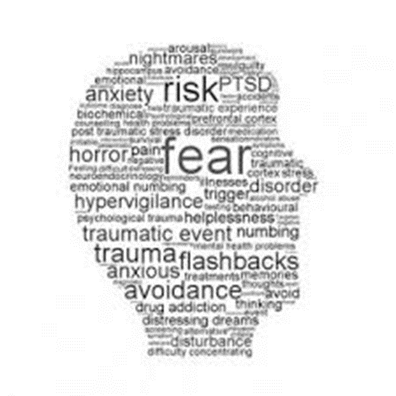
Background
Trauma –
unique individual experience of an event or enduring conditions, in which; the individual's ability to integrate his/her emotional experience is overwhelmed or the individual experiences (subjectively) a threat to life, bodily integrity, or sanity
(Pearlman & Saakvitne, 1995

Slide 3
Background
Homelessness is traumatic. People experiencing homelessness are living with a multitude of losses.
People experiencing homelessness have lost the protection of home and community, and are marginalized, isolated, and stigmatized within society at large.
People who are experiencing homelessness are highly vulnerable to violence and victimization
(SAMHSA)
Notes:
Sydney found that 98% of participants had experienced at least one trauma and 93% had experienced two or more. (average number was 6 Sample=53)
first trauma experience having occurred by the age of 12. 73% lifelong prevelance of PTSD. 59% showed PTSD onset before homeless.
Dublin study: 95% 1 or more trauma events. 46% met PTSD criteria.
We are in the business of supporting homeless recovery and in doing so are indirectly drawn into trauma management. This puts particular pressures and stressors on our staff and services systems of care

Slide 4
Trauma Informed Care
A trauma informed service is one that understands the underlying psychological impact that trauma may have on an individual and incorporates their understanding and awareness into their practices and every aspect of the service delivery (SAMHSA, 2014)
Notes:
Ultimately offers a trauma lens through which we can take a new/alternate perspective of the service user and can utilise this in the creation of policies and procecduers that are cogniscent of trauma symptoms and triggers.

Slide 5
Trauma Informed Care
Trauma Informed Care
Trauma Understanding
Trauma Informed Practice
Notes:
While we won’t be able to offer you a complete program of understanding trauma and TIP’s we can show you the process through by which we travelled to retro-fit TIC into CSC

Slide 6
Our TIC Journey
Research origin: Trauma existence – anecdotal
Project Aims:
Establish the prevalence of trauma within Cork Simon Community.
(b) Assess Cork Simon Community’s capacity for Trauma Informed Care.
(c) Ascertain the implications of the findings for clinical and non-clinical interventions within homeless settings
Notes:
Move from anecdotal into the tangible

Slide 7
Model Roll out
ACE Study
Staff Compassion Levels
Agency Audit
Trauma Training

Slide 8
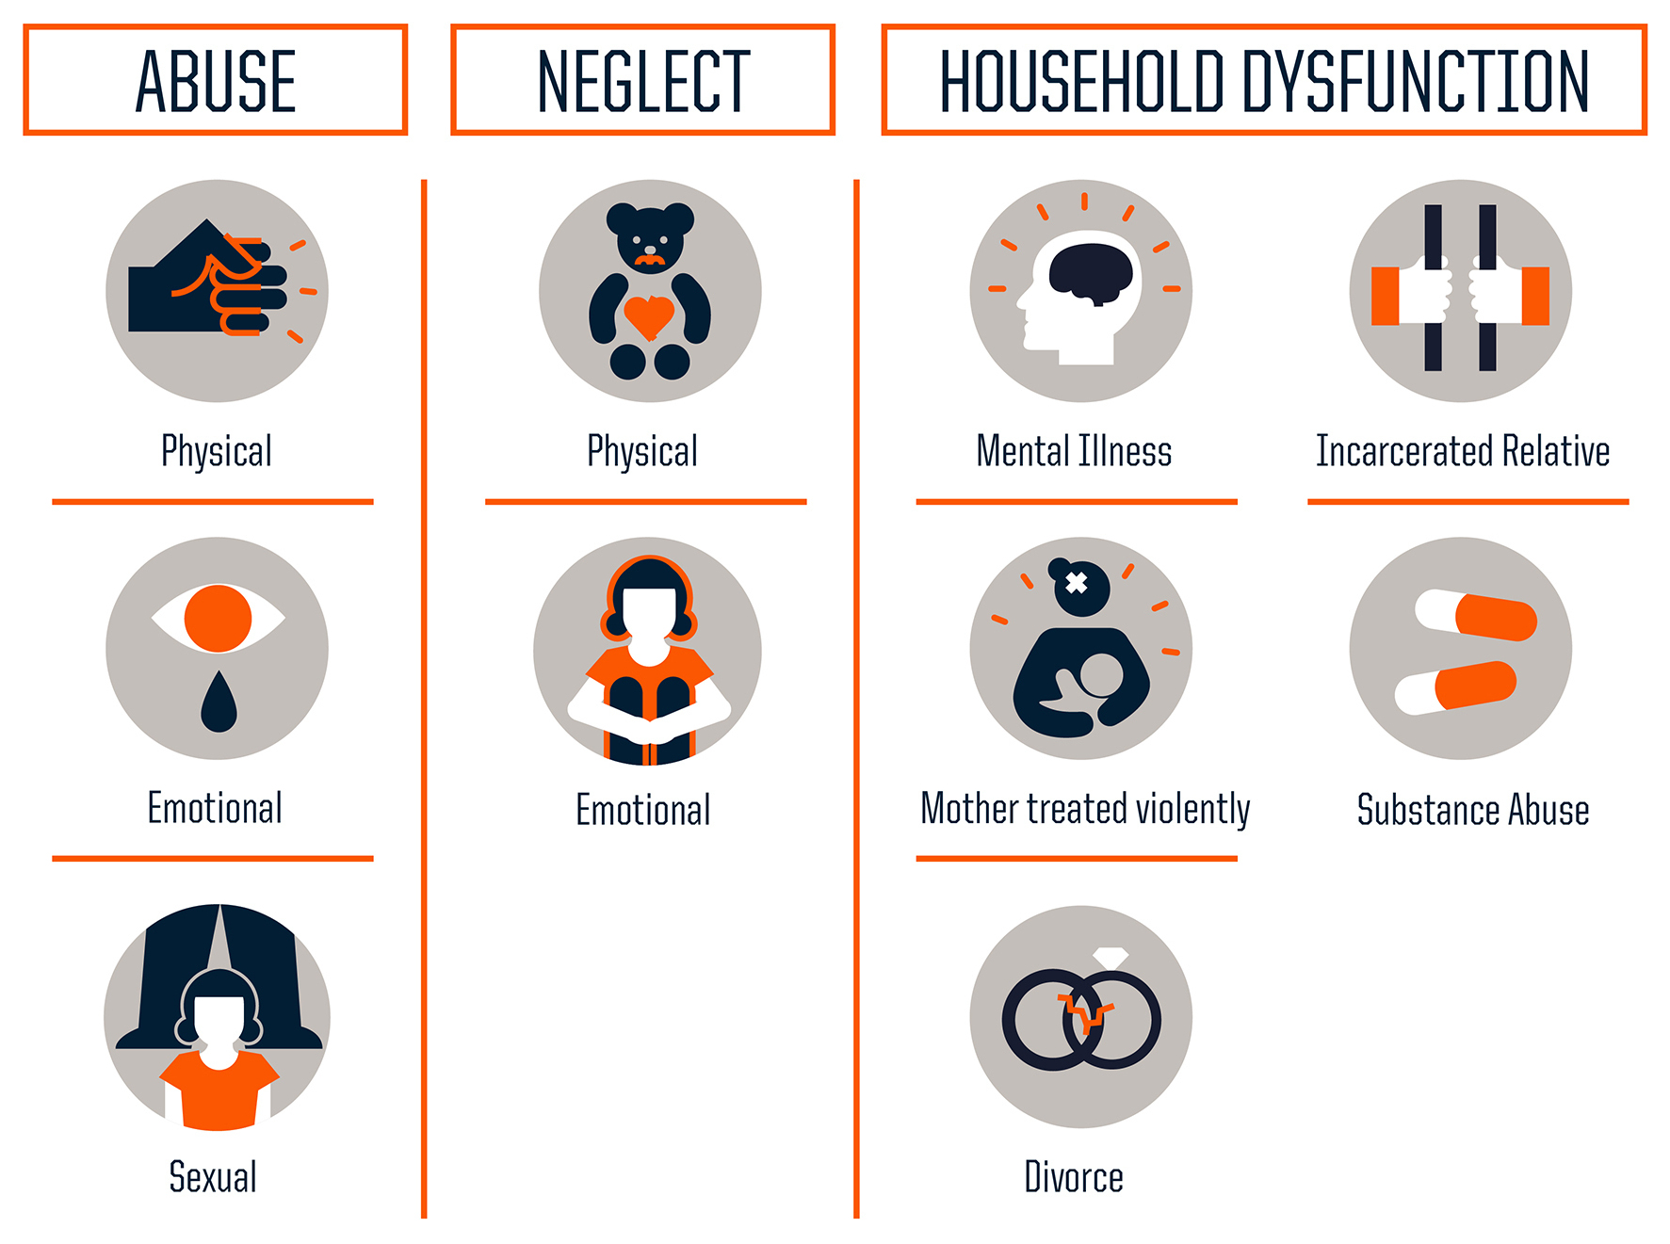
Aim 1: Prevelance of Trauma
ACE Study

Slide 9
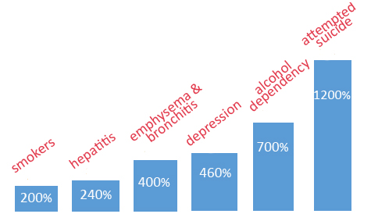
ACE Dose Responses (Felitti et al, 1998)
ACE Score 3 Marks threshold of pathological risk
ACE Score 4 +
Notes:
Under three out of ten is the pathological cut off without too much issue.

Slide 10
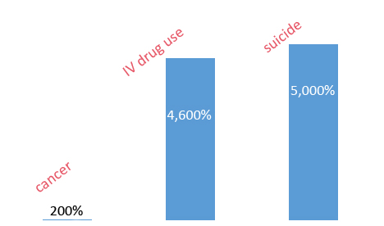
ACE Dose Responses (Felitti et al, 1998)
ACE Score 6 +
Notes:
If we could identify a pollutant or chemical that could cause this much damage we would be targeting all of our interventions at it.

Slide 11
ACE Progression

Slide 12
Exercise
Consider a specific client in your organisation where you know at least a basic level of their history
Complete yellow ACE form for their case
Notes:
Who scored above 3 because 3 is the pathological threshold for ACE. 3 or above and your remain relatively unscathed
4 – Say a little
5
6 – Say a little
7, 8, 9, 10

Slide 13
Participants
Participants
Participants: 50
Age Range: 20 – 45 years
Nationality: Irish 86%
Other 14%
Notes:
Dual service users of Cork Simon Community (Age 18+) and the HSE Adult Homeless Integrated Team
This offered some clinical support post interview should the participant suffer from a high level of distress during interview.

Slide 14
ACE Scores by Gender
Notes:
Blue=men Red=women
Average ACE score 5.38
74% of participants scored ≥ ACE 4

Slide 15
Breakdown across categories
ACE Scale Item | % (N:49)
Verbal Abuse | 75.5%
Physical Abuse | 67.3%
Sexual Abuse | 34.7%
Emotional Neglect | 67.3%
Physical Neglect | 26.5%
Loss of Parent | 49.0%
Mother Victim of Domestic Violence | 42.9%
Substance Abuse in Family | 71.4%
Mental Illness in Family | 59.2%
Incarcerated Family Member | 30.6%
Notes:
Verbal
Phyiscal
Emotional
Substance

Slide 16
Biological
Averaged 17 trips to A&E (Range 4 – 40)
47% had experienced serious head injuries
62% people had at least 1 overdose

Slide 17
Psychological
46% reported self harm while 64% reported having had suicidal thoughts
90% reported having seen psychiatrist or psychologist
90% believed they had psychological problems while 23.5% reported knowing a diagnosis
35% reported being on psychoactive medications
Notes:
Psychological Problems: depression, anxiety, psychosis, PTSD, ADHD, EUPD, Bipolar and schizophrenia
Psychiatric medication: psychotics, SSRIs, benzodiazepines, methadone and sleeping tablets

Slide 18
Social
Average length of homeless: 6 years
Average age left school: 15.9 years (range 10 – 19)
Children:
46 children in total between 50 participants
20% had children in care
31% had been in care themselves

Slide 19
Substance Use & Addiction Information
Heroin 75.8%
First used: 22 years old
First injected: 26 years old (range 13 – 44)
Alcohol 9%
First used: 12 years old (range 10 - 19)
20% using alcohol before this point
Cannabis
First used: 14 years old (range 10 – 45)
62% by age 13
Notes:
75.8% had abused heroin (74% currently IV users and 44.2% having shared IV equipment)
(53% had abused alcohol in the past)

Slide 20
Substance Use & Addiction Information
Gambling 17%
17% reported problematic gambling
Treatment 82%
82% had previous addiction treatment with an average of 3 treatment episodes
Reasons for treatment breakdowns included: ethos, treatment demands, poor aftercare and interpersonal issues with other service users

Slide 21
Service User Feedback
Levels of distress
Average 4.08 out of 10 (range 1 – 10)
82% rated their level of distress at 6 or under
Interviewers experiences:
At times interviewers reported higher levels of distress than clients (Mean – 5.67; range 5 – 6)

Slide 22
Service user feedback
Client noted that in doing the ACE Questionnaire he noted just how much things have improved in his family of origin since he turned 18 years old.
Client took a look through ACE literature after filling in the questionnaire & spoke about how it made sense to his experiences in life & with his addiction & educational progress.
Good to ask these questions. 'I always wonder, was I born an addict, or was it because my family put me into care?'
If you spend your life getting abused/ let down by people, you lose trust in people and how can you then be expected to walk into an NA meeting full of people?’
It depends if you feel comfortable talking to the person. When you know you are not getting judged. There is not enough support. You are just another number. The problem is just getting passed on.

Slide 23
Staff Compassion Levels

Slide 24
Staff Trauma Contagion
55 Staff across the spectrum of roles
30 item self-report measure to assess:
Compassion satisfaction - ↑ high scores = greater satisfaction related to your ability to be an effective caregiver
Burn-out - ↑ high scores = ↑ hopelessness and difficulties in dealing with work
Compassion fatigue - ↑ high scores = exposed to frightening experiences at work

Slide 25
Staff Trauma Contagion
 |  | Compassion Fatigue |  | Burnout |  | Secondary Traumatic Stress
Low |  | 20% (n. 11) |  | 20% (n. 11) |  | 25.5% (n. 14)
Average |  | 56.4% (n.31) |  | 61.8% (n. 34) |  | 49.1% (n. 27)
High |  | 23.6% (n. 13) |  | 12.7% (n. 7) |  | 25.5% (n.14)
Notes:
¾ staff score within the average or high severity categories for CF and burnout.
¾ roughly corresponds to those that have an average or high compassion satisfaction.
possibly speaks to the ethos and value system of staff that they can continue to feel rewarded through the work they do despite its erosive nature

Slide 26
Exercise
Consider your own work.
Complete ProQOL form for yourself in your work.
Notes:
Discuss scores

Slide 27
Aim 2: Assess Agency’s capacity for Trauma Informed Care
Consumer Involvement
Supporting staff development
Safe & Supportive Environment
Assessment & Care Planning
Policies
Agency Audit

Slide 28
Trauma informed Agency Self Assessment
Instrument assesses across 5 domains
Completed across every point of the care/support continuum
Completed in a mixed assessment format
‘Secret shopper’
Team leader
Staff trauma champion
Notes:
5 domains – Supporting staff development; Safe & Supportive Environment; Assessment & Care Planning; Consumer Involvement; Po
Policies
outreach, day centre, HESS, High Support, Transitional and Housing Support

Slide 29
Audit Findings
Many of existing policies and procedures are operating from a place that provides for working with deeply traumatised people
Areas for improvement were mostly constrained by resources issues: single occupancy rooms, lack of staff rooms, waiting list for counselling service, a day service that is now too small for demand
Issues identified beyond org’s control: National paperwork that is not strength based; centre of interest issues
Notes:
5 domains – Supporting staff development; Safe & Supportive Environment; Assessment & Care Planning; Consumer Involvement; Policies

Slide 30
Trauma Training

Slide 31
Trauma Training
Informed by the other three research areas: ACE, ProQOL and audit
120 staff trained in 3 weeks across all roles from housekeeping and admin up to senior management
Training took three tiers:
Ancillary Support Staff
Front line workers
Middle & Senior Management
Notes:
5 domains – Supporting staff development; Safe & Supportive Environment; Assessment & Care Planning; Consumer Involvement; Policies
Tier 1: Ancillary Support Staff. ½ day – Understanding trauma; recognising triggers, self care and staff input into creating TIC
Tier 2: Front line workers. Full day – All of tier 1 with greater emphasis on how to develop TIC using SWOT of policy & practice
Tier 3: Middle & Senior Management. Full day –All of above; emphasising feedback from Tier 1 & 2 and exploring alterations to policy and practice.

Slide 32
TIC Model
ACE Study
Staff Compassion Levels
Agency Audit
Trauma Training
Offered a base line of Service User childhood trauma & staff trauma contagion
Offered an understanding of the service strengths & weakness’ as regard Trauma Informed care provision at a micro and macro level
Trauma Training offered:
Frontline staff a new trauma lens
Management a greater understanding of frontline stress points
Offered a qualitative dimension and understanding of the quantitative data
Delivered a solution focused forum for TIC delivery

Slide 33
Recommendations
Pilot to include the ACE questionnaire as part of the initial assessment
A complete SU screening for SU’s already in the service
Changes in format of line supervision
Agency rules – reducing them and making them more universal. Also counterbalancing them with SU rights
Changes to certain physical environments within the service
Create a ‘trauma informed change team’ to implement recommendations
Notes:
Supervision – changes in format – separating out case management support from staff support. Offering an emphasis on a trauma lens within supervision.

Slide 34
Researchers Cork Simon Community – Graham Gill-Emerson (Addiction Counsellor) University College Cork – Dr. Sharon Lambert (Forensic psychologist) Health Service Executive - Dr. Aidan Horan (Methadone GP) & Dr. Anna Marie Naughton (GP) Data Collection: Mary Tobin, Ailicja Wislocka and Eimer McGarry Ethical approval was granted through UCC School of Applied Psychology

Slide 36
Further Research

