Slide 1
“T'ain't What You Do (It's the Way That You Do It), that’s what gets results”: What works to Improve the Health of the Multiply Excluded?
Dr Nigel Hewett OBE FRCGP
Medical Director Pathway
Secretary to the Faculty for Homeless and Inclusion Health

Slide 2
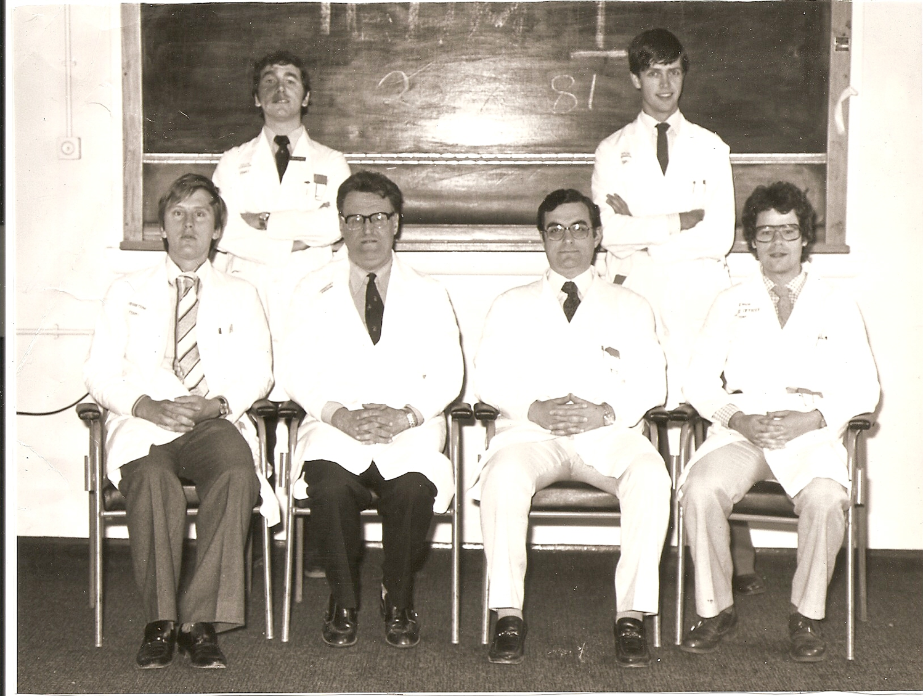

Slide 3
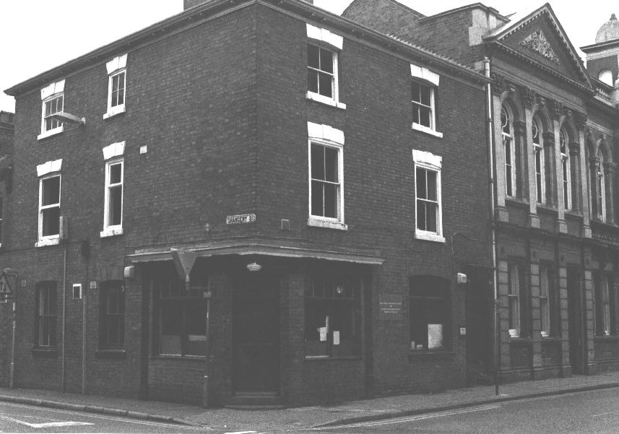

Slide 4
David Ogilvy
Recruit people who are better than you, then step back and take the credit
Because the alternative is to do the opposite, step up and take the blame
Notes:
Father of Advertising

Slide 5
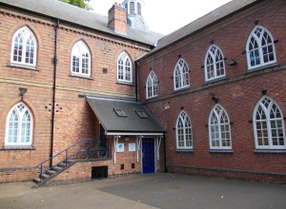
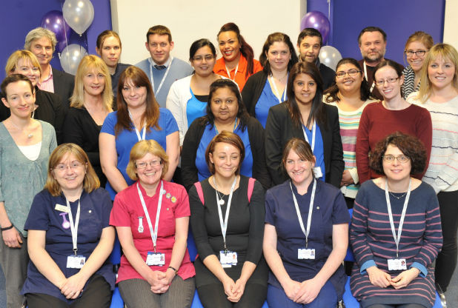
CQC “Outstanding” November 2014
“I am delighted to highlight the exceptional standard of care which is being provided by Inclusion Healthcare. The service has a clear vision to improve the health of vulnerable and excluded groups - such as homeless people, refugees or those with learning disabilities.
Professor Steve Field, Chief Inspector of General Practice

Slide 6
University College London Hospital

Slide 7
Pathway hospital team

Slide 8
Pathway Charity
Developing and implementing integrated models of healthcare for excluded people
Research and publications
Training, conferences and qualifications
Involving homeless people in this work

Slide 9
Notes:
This has led to awards

Slide 10
2016 National Kate Granger Award for Compassionate Care in the NHS
Notes:
Most recently the Kate Granger award

Slide 11
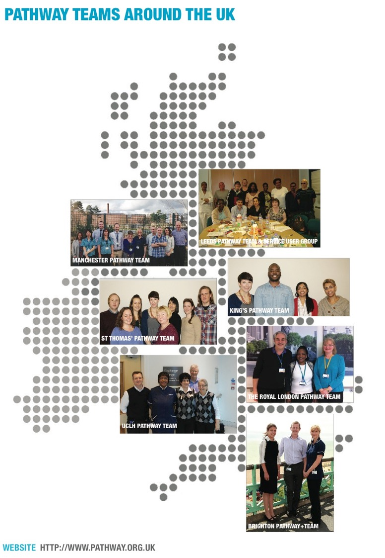
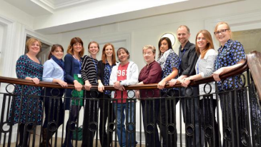
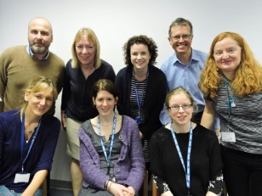
Notes:
Teams in 10 Trusts and plans for more. All mainstream NHS employees, locally funded.

Slide 12
Pathway – what is the evidence?

Slide 13
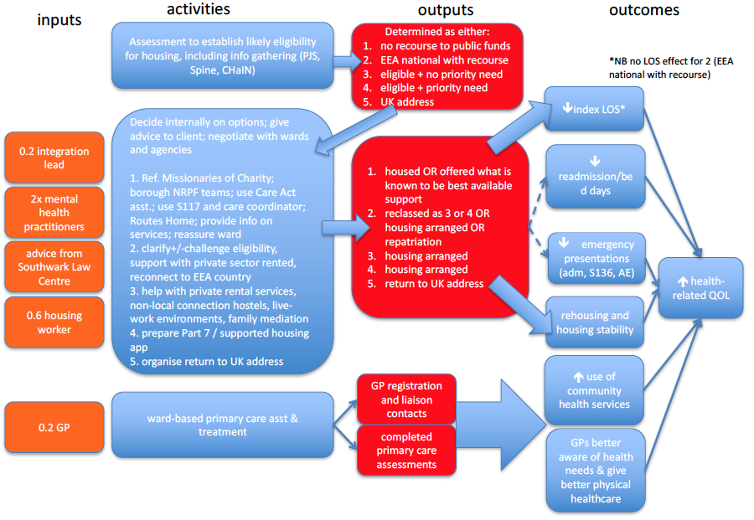

Slide 14
Quality – UCLH feedback
You were the only ones that felt my life was worth saving- I am now back with the family I have not seen for 10 years
I’ve never stayed in hospital as long as this (2wks), I trust you, that’s why I am staying
The change is tangible, ...full confidence that contacting the team will produce results
Joint working with housing options has greatly improved customer care
..enormous support with complex substance misuse clients at UCH

Slide 15
Newest team in SLAM
Dr. Jonathan Beckett, Consultant on Triage Ward and Chair of the Consultants Group at the Lambeth Hospital says our team has “helped to promote a social and moral conscience in us all”
Dr. Rob Harland Consultant Psychiatrist and Chair of the Consultants Group at the Maudsley Hospital says:
“These people are very bright, they know the law. They can get to grips in 15 minutes with issues it takes us 2 hours to even start to work out. They’re brilliant.”

Slide 16
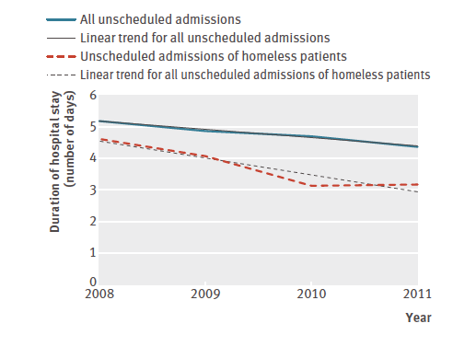
Hewett et al. A general practitioner and nurse led approach to improving hospital care for homeless people BMJ 2012;345:e5999

Slide 17
KHP Pathway Outcomes – all homeless patients attending
Context - Rough sleeping in London has increased by 90% between 2010/11 and 2014/15 after a steep decline in the 2000’s
9% reduction in A&E attendances, an 11% reduction in bed days in the measured cohort, 56% showed improved housing outcomes and the average length of stay reduced from 3.2 to 2.6 days
Dorney-Smith S, Hewett, N, Khan, Z, Smith R (2016) Integrating health care for homeless people—the experience of the KHP Pathway Homeless Team. BJHCM 22(4): 225–34

Slide 18
2 Centre RCT – Royal London & Brighton
Quality of life scores (EQ5D-5L) improved post discharge for Pathway patients
Proportion of people sleeping on the streets reduced from 14.6% in standard arm to 3.8% in Pathway arm
The increased quality of life cost per QALY was £26,000
http://www.clinmed.rcpjournal.org/content/16/3/223.full.pdf

Slide 19
Early results from SLAM regression modelling
LOS
Alongside whether or not the person was treated by the homeless team, the regression model included primary diagnosis, legal status, the recording of a homeless address, borough link of the first admission ward and date of discharge.
It included 185 treated patients and 223 control patients, all admitted after August 2014. This comprises 408 of a possible total 457 patients (89%), the difference being accounted for by missing data.
LOS was estimated to be 25% lower among the treated group (p = 0.002; 95% CI 10% to 37%).
Readmission
The Cox regression model included marital status and number of admissions in the preceding 2 years alongside treatment (or not) by the homeless team.
The rate of readmission was estimated to be 37% lower among the treated group (p = 0.044; 95% CI 1% to 60%)

Slide 20
Do Values add Value?
Professor Michael Porter Harvard Business School (at a UCLP masterclass 2010) – “value means outcomes that matter to patients expressed in terms of the cost of the whole care cycle”
“Cost reduction without regard to the outcomes achieved is dangerous and self defeating, leading to false “savings” and potentially limiting effective care

Slide 21
Inclusion Health – Extreme Medicine?
Marginal medicine, outliers (complexity, multi-morbidity) Standing alongside our patients – nothing left to lose
Surfing the breaking edge of chaos
Hotbed of innovation – primary care based drug and alcohol treatment, hepatitis C treatment, PD treatment, outreach care to hostels, drop in’s and the streets
Multidisciplinary care & reflective practice
Experts by experience

Slide 22
The Faculty for Homeless and Inclusion Health
Free network of people working with:
Vulnerable migrants
People involved in the sex industry
Homeless people
Gypsies and Travellers
Research updates, low cost CPD, regional and special interest meetings
www.pathway.org.uk/faculty

Slide 23
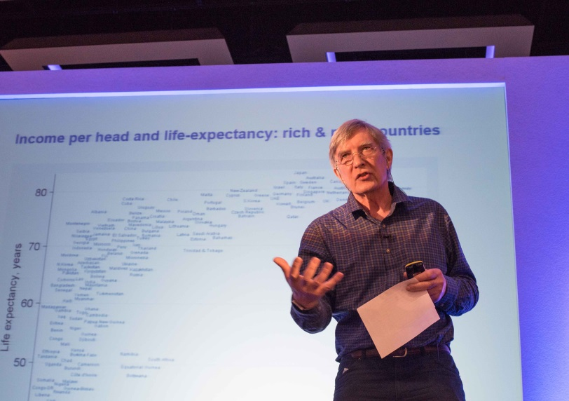
International Symposium on Homeless & Inclusion Health
300 professionals and Experts by Experience
Speakers from across the world, past examples:
Professor David Nutt
Professor Graham Foster
Professor Dame Sue Bailey
March 2018 www.homelessnessandhealth.co.uk

Slide 24
Post-Graduate Module in Homeless and Inclusion Health
The module will sit within Population Health in the Institute of Epidemiology and Healthcare UCL
Pitched at introductory level, requiring no prior knowledge.
Assessed for those requiring points to MsC, or can be stand alone CPD.
Aspire to becoming core qualification for this field
Begins summer 2018!
http://www.ucl.ac.uk/iehc/study/postgraduate_taught/msc-population-health/short-courses

Slide 25
The Future – Health Equity
Inclusion Health a recognised speciality or special interest
The whole of the NHS, Social Care, Housing and the Voluntary Sector recognising a duty to collaborate for health equity.
Inequality is about difference/distribution
Equity = equality + justice!

Slide 27
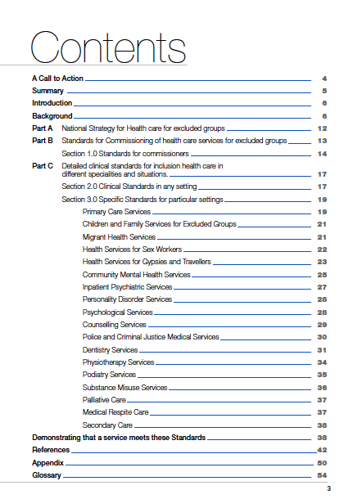
2013 – DH funding from the National Inclusion Health Board supported the Faculty to develop a revised set of Standards to include Gypsies and Travellers, vulnerable migrants and sex workers

Slide 28
What works in Inclusion Health: overview of effective interventions for marginalised and excluded populations
In press 2017
An evidence synthesis of health and social interventions for exemplar Inclusion Health target populations, including people with experiences of homelessness, drug use, imprisonment, and sex work.

Slide 29
Inclusion Health?
Inclusion Health is a service, research, and policy agenda that aims to prevent and redress health and social inequities among the most vulnerable and excluded

Slide 30
Policy Implications
The most effective means of preventing the adverse life experiences and disadvantages faced by socially excluded populations is to reduce material poverty and deprivation, especially among families with children that are at high risk of maltreatment.
Within proportionate universalist priority-setting frameworks (where actions to reduce inequalities are across the population, but the level of investment is proportionate to the level of disadvantage), excluded groups should be given a highly prioritised position, reflecting the intensity of their needs and exceptionally poor outcomes.
Notes:
20, 30, 40 years later in Wellington Park

Slide 31
Policy Implications
National and local social and health policies for assisting Inclusion Health target populations should be based on the twin principles of 'personalisation' and 'deinstitutionalisation' .
The provision of suitable and stable housing in ordinary community settings should be an overriding policy objective in strategies tackling social exclusion.

Slide 32
Records identified through database searching (n = 3467)
Additional records identified through expert opinion (n = 14)
Identification
Records after duplicates removed (n = 2651)
Screening
Records screened (n = 2651)
Records excluded (n = 2379)
Full-text systematic reviews assessed (n = 272)
Full-text articles excluded, with reasons (n = 182)
Eligibility
Pharmacological
Interventions Total (n = 90)
Included (n = 22)
Psychosocial
Interventions Total (n = 71)
Included (n = 13)
Case Management
Interventions Total (n = 7)
Included (n = 4)
Interventions for Prevention
Total (n = 24)
Included (n = 9)
Interventions for Housing/Soc Dets Total (n = 4)
Included (n = 3)
‘Other’
Interventions Total (n = 25)
Included (n = 7)
Interventions for Women
Total (n = 28)
Included (n = 10)
Interventions for Youth Total (n = 23)
Included (n = 9)
Included
Studies included in qualitative synthesis (n = 77)
Notes:
PICO methodology population, intervention, comparator, outcome

Slide 33
Intervention categories
Pharmacological
Psychosocial
Case management
Disease prevention
Housing & social determinants
“Other”
Women & youth (because majority of populations studied consist of middle aged men)

Slide 35
Integration - examples
e.g. for HIV & SUD, multicomponent nurse led care with contingency management & directly observed therapy much better than isolated interventions
Multicomponent harm reduction programmes: needle & syringe programmes, behavioural interventions, Rx for SUD, & syringe disinfection - reduce risk of hepatitis C infection by as much as 75%, but single component interventions are minimally effective
Notes:
SKIP!

Slide 36
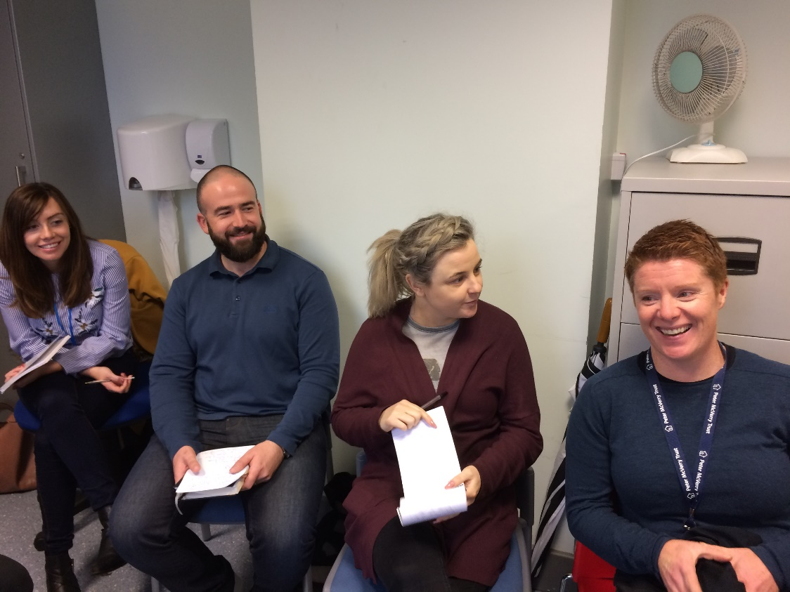
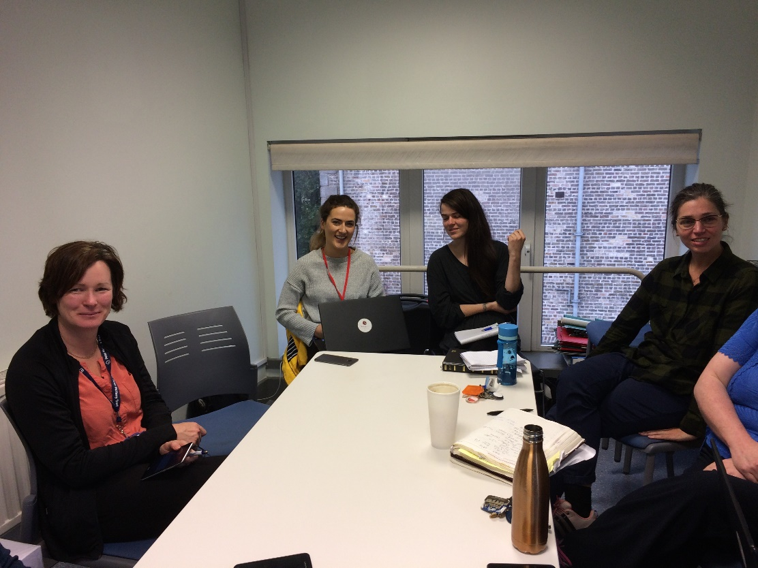
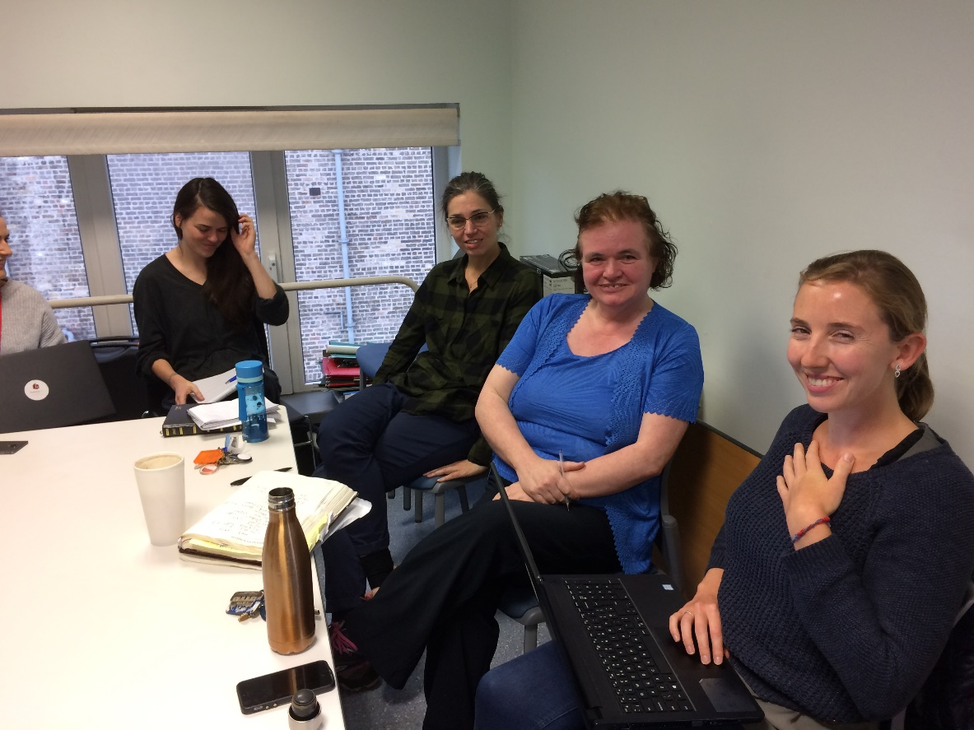

Slide 38
It’s not what you do, it’s the way that you do it!
non-judgmental approach, ensuring confidentiality, providing a supportive interpersonal environment, creating safe communal spaces, and identifying common priorities, needs, and goals
Start where the person is at, begin with their priorities.

Slide 39
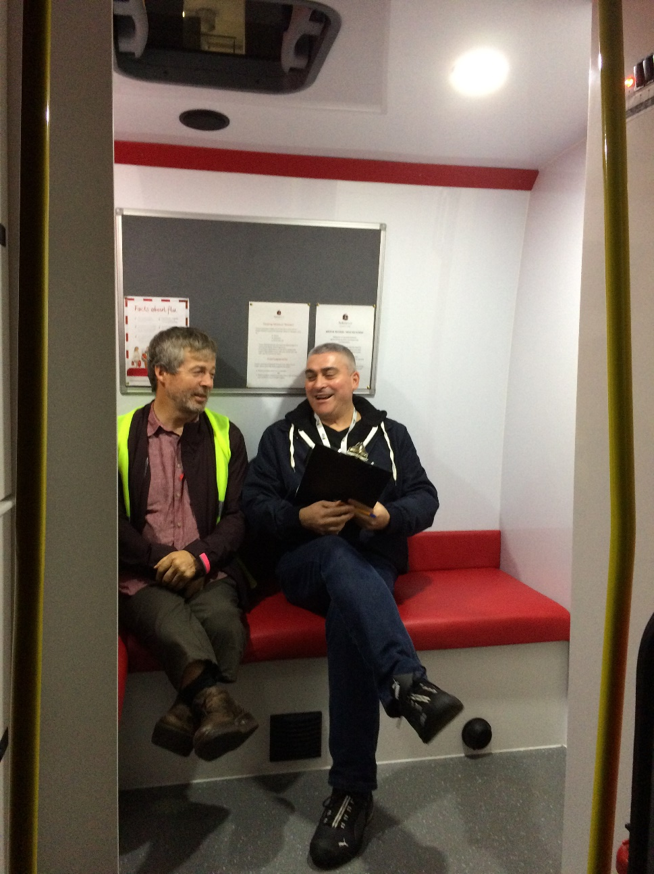
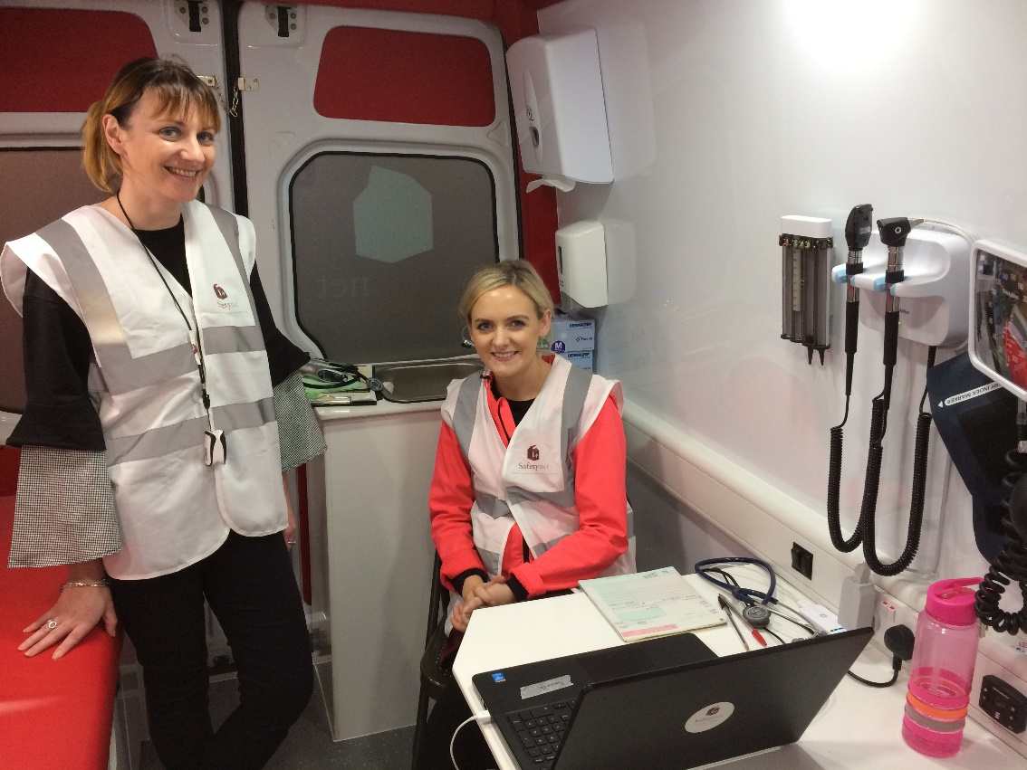
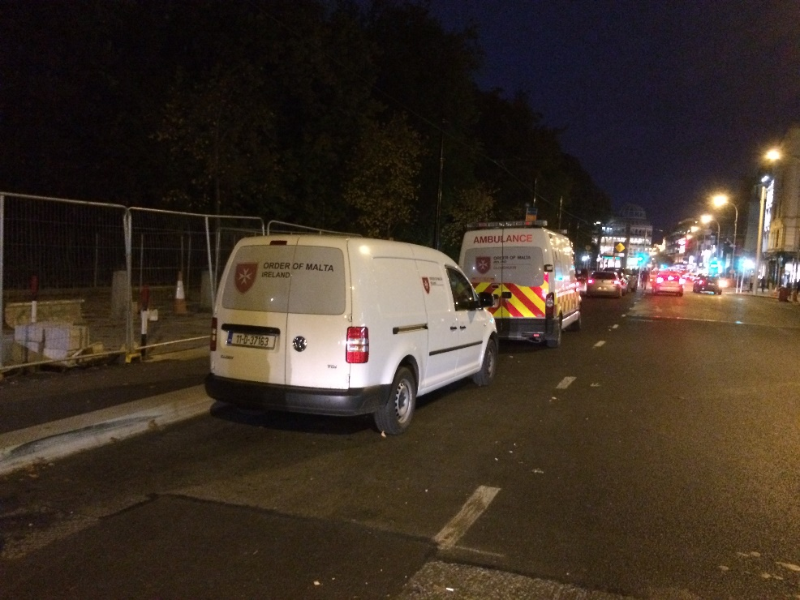

Slide 41
It’s not what you do, it’s the way that you do it!
Multimodal psychosocial interventions advised, e.g. motivational interviewing & CBT together improve drug use and mental health outcomes, & prevent re-incarceration when used in therapeutic communities
Notes:
SKIP!

Slide 42
It’s not what you do, it’s the way that you do it!
Peer workers & specialised community nurses best placed to act as outreach and ‘in-reach’ personnel to actively engage people ‘where they’re at’ and to advocate

Slide 43
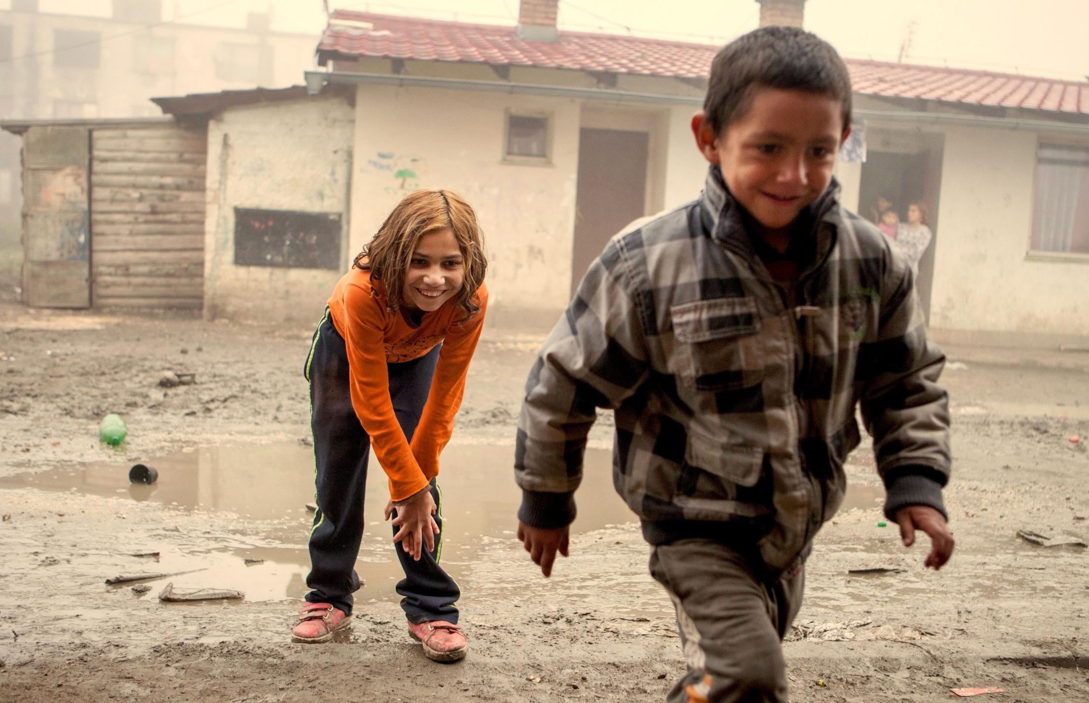
Health is a human right
Do something
Do more
Do better

Slide 44
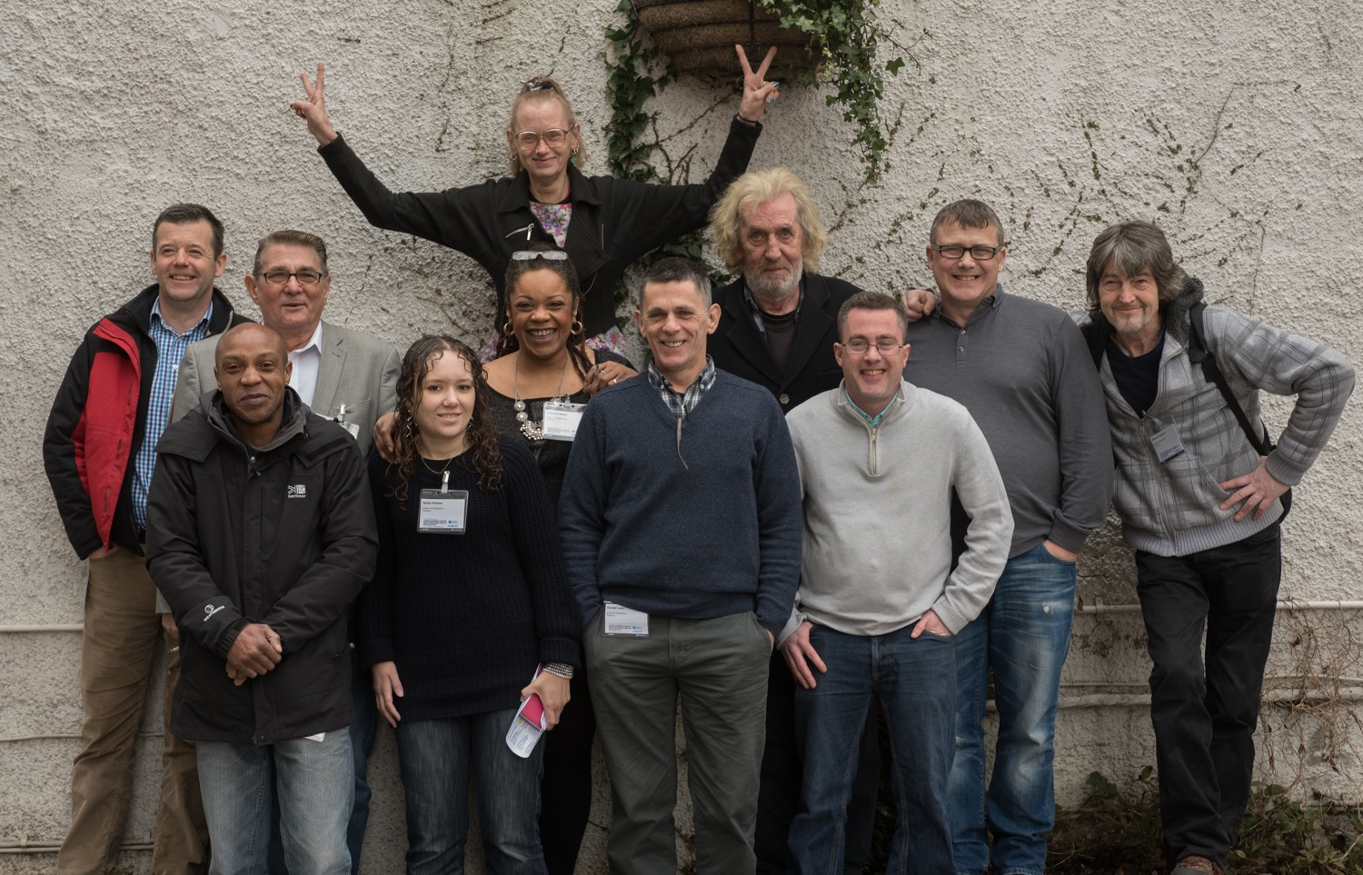

Slide 46
Peers support & involving experts by experience works for service design and delivery – ”walked the walk” with Lancet paper
Pathway teams a promising example

Slide 47
Individual care coordination supported by a multi-disciplinary team
Care coordination or case management includes assessment, planning, linking health and social services, monitoring, and advocacy

Slide 48
Individual care coordination supported by a multi-disciplinary team
More than anything a trusting relationship with someone who cares

Slide 49
‘healthcare is a right and everyone should have a voice.’

Slide 50
www.pathway.org.uk
www.pathway.org.uk/faculty
www.homelessnessandhealth.co.uk
info@pathway.org.uk
+44 20 3447 2420
PathwayUK
PathwayUK

