Slide 1
Palliative care for homeless people
Dr. Aoibheann Ni Chonfhaola
Dr Regina McQuillan
Notes:
Hello
My name is Aoibheann Ni Chonfhaola. I am a doctor training in palliative medicine in Ireland. Today I will be speaking on the topic of palliative care and the homeless. I have an interest in the provision of palliative care for the homeless, and together with Dr Regina McQuillan, we have been looking at our role in palliative care in Ireland, and how we work people who are homeless and the staff who work with homeless people. Our objective is to improve the delivery of palliative care to homeless people who may benefit from our service, and to forge relationships with disciplines and specialties
Today I will present -
what do we mean when we say ‘palliative care’
discuss briefly palliative care services in Ireland
discuss who ‘palliative care’ is for
touch on projects and research here and internationally
and to tell you about work we are conducting
The reason we wanted to speak today is to use this a opportunity to promote ourselves, to demystify what we do, and make some contacts. So I have nine minutes to do that!

Slide 2
What is palliative care?
Palliative care is an approach that improves the quality of life of patients and their families facing the problem associated with life-threatening illness, through the prevention and relief of suffering by means of early identification and impeccable assessment and treatment of pain and other problems, physical, psychosocial and spiritual.
Notes:
So what exactly is palliative care? The WHO define Palliative care as an approach that improves the quality of life of patients and their families facing the problem associated with life-threatening illness through the prevention and relief of suffering by means of early identification and impeccable assessment and treatment of pain and other problems, physical, psychosocial and spiritual.
That’s quite a mouthful, but in essence our service consists of doctors, nurses, social workers, physiotherapist, occupational therapists, pastoral care, psychologists who work to provide care for people who have diagnosis of an illness that will shorten their life. We aim to improve their quality of life by managing physical symptoms (like pain) but, we also acknowledge that life if more than just physical well-being, and through our MDT we address other issues associated with dying.
Access to palliative care is a human right. There are a number of key statements that urge governments to integrate palliative care into health systems, the most recent being the Prague Charter. This applies not just to patients in countries that do not have good palliative care services, but also in countries such as Ireland which is considered to have a high standard of palliative care services. There are groups of patients, such as homeless people, who for one reason may not traditionally have accessed our service in the past.

Slide 3
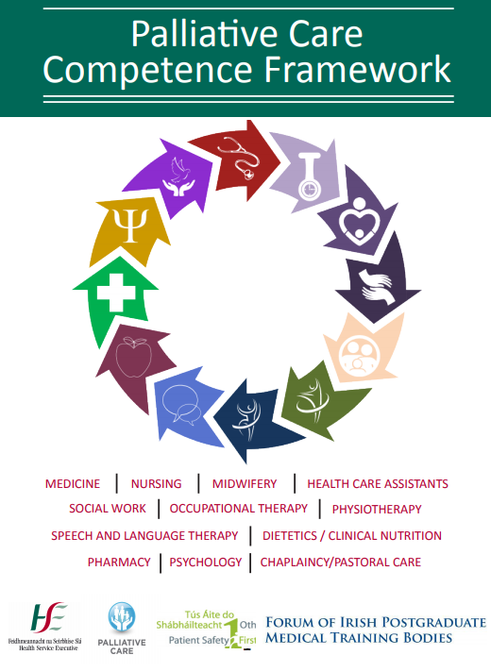
Who provides Palliative care?
- EVERYBODY!
- Acknowledging that someone has a life limiting illness
- GPs
- PHNs, CNSs,
- Social workers
- AHPs
- Chaplaincy / pastoral care
- Families
Notes:
Every person in the world will die, and every person in the world is entitled to respect, dignity, comfort, and to be pain-free at the end of their life. For a lot of people this can be achieved through the care from their own their own doctor and nurses but for some patients their needs are such that involvement of our team is appropriate. Most of our work is collaborative, alongside other specialties and disciplines.
Think of palliative care as an approach to care, rather than something specific that only we as specialist in the area can provide.
The palliative care competency framework is an excellent document that outlines the expected competencies of different health care professionals working with patients or services users who have a life limiting illness – it is a very useful document for those of you in service organisation and policy development who may be looking at end of life care within your service.

Slide 4
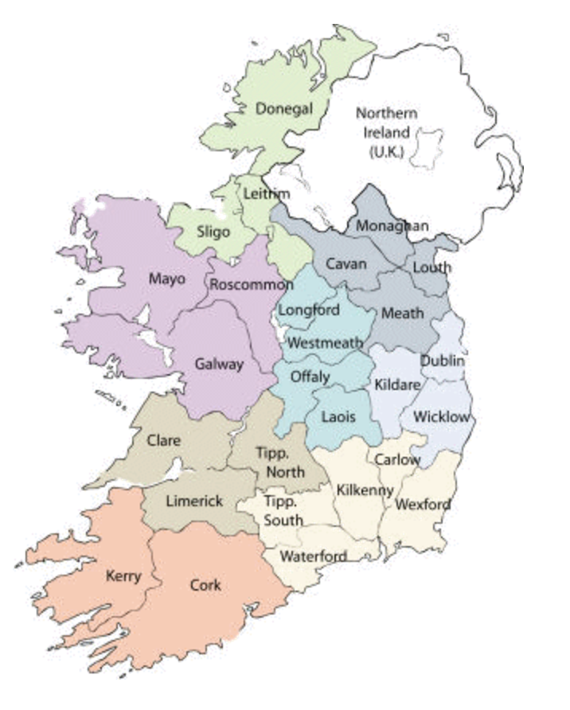
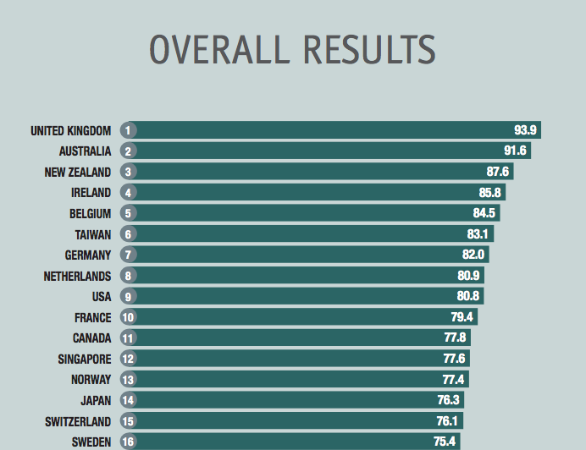
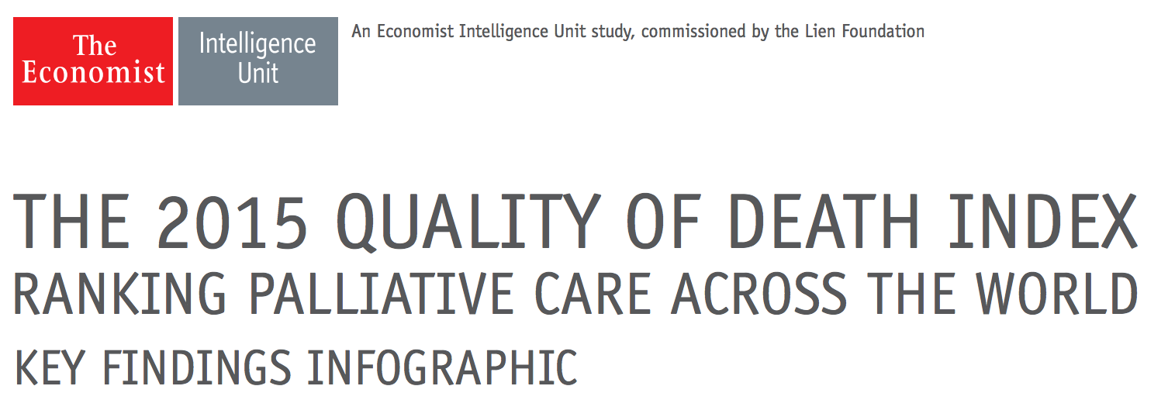
Specialist Palliative care services in Ireland
Hse.ie/palliative care programme
Resources
National referral form
Directory of services and contact details
IAPC website
Notes:
The palliative care services in Ireland are based in hospices, in hospitals, and also in the community where nurses and teams will travel to the patients homes. Take Limerick as an example where I working presently - there is a 34 bedded hospice in Milford, there are 4 consultants covering Clare, Limerick and North Tipperary, there are community nurse teams in each of these areas, I am the single NCHD working with the community team, and we also work in the Regional hospital Limerick. Patients are referred to our service by their GPs or their hospital doctors.
There is a national referral form that is used throughout the country for referral to our services and details of this can be found on the HSE website.
Internationally Ireland is considered to have a very high standard of palliative care, and the Economist Intelligence Unit rated it the 4th best country to die in in the world. Our question is, is it that “good” for everyone?

Slide 5
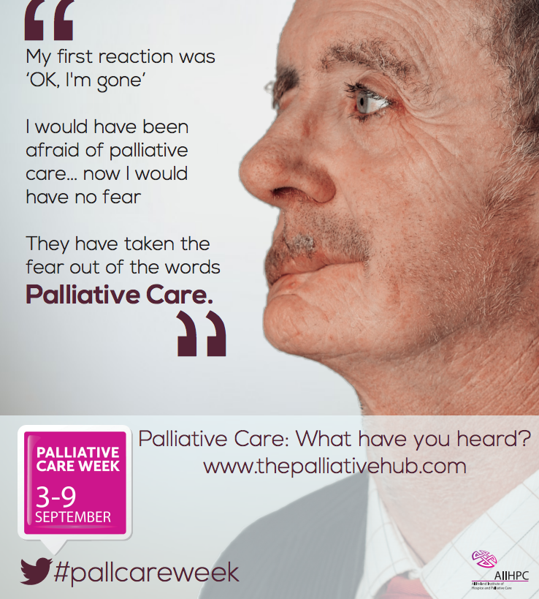
What do we do in palliative care
Palliative Care
End of life care
Supportive care
Notes:
So let’s talk about death, dying and palliative care.
To deconstruct where we fit in among other health services I think of palliative care as having two major work streams.
The main one that most people think of when they hear palliative care, is looking after people who are dying.
The other side, and probably the bigger component of our work load, is providing care (alongside GPs, and other specialists) for those people who will probably die soon, in the next weeks or months, and who have what is termed a ‘life limiting illness’ – an illness that they will die from. For some people this is cancer, and for others this is advanced lung disease or advanced liver disease, or advanced heart disease, and we are involved in symptom management, advanced care planning and end of life care planning for these patients.
A common misconception is that ‘palliative care’ is just for patients who have cancer, this used to be the case, but is certainly not true now.

Slide 6
THE PATIENT
Notes:
We aim to have the patient at the center of our care

Slide 7
GP
HOME
FAMILY
THE PATIENT
PHYSICAL CARE NEEDS
PHN
HOSPITAL SPECIALIST
PSYCH
NEEDS
ACCESS TO MEDICATIONS
Notes:
And to work with all the other health and community services that can help them live and function as well as they can

Slide 8
Where do Irish people die?
While 67% of Irish people express a preference to die at home
in reality only 26% of the circa 28,000 deaths that occur in Ireland each year take place in the home
43% occur in hospital
40% of all patients cared for by hospice home care teams die at home
WHAT HAPPENS IF YOU DON’T HAVE A HOME?
Let us think about health and dying for homeless people
Notes:
Of the general Irish population 67% of people express a preference to die at home,and in reality about 26% of deaths occur at home. Your chance of dying at home increases if you have the involvement of the palliative care team. The majority of deaths occur in hospitals.
But what happens if you don’t have a home?
Lets think about health and dying for homeless people

Slide 9
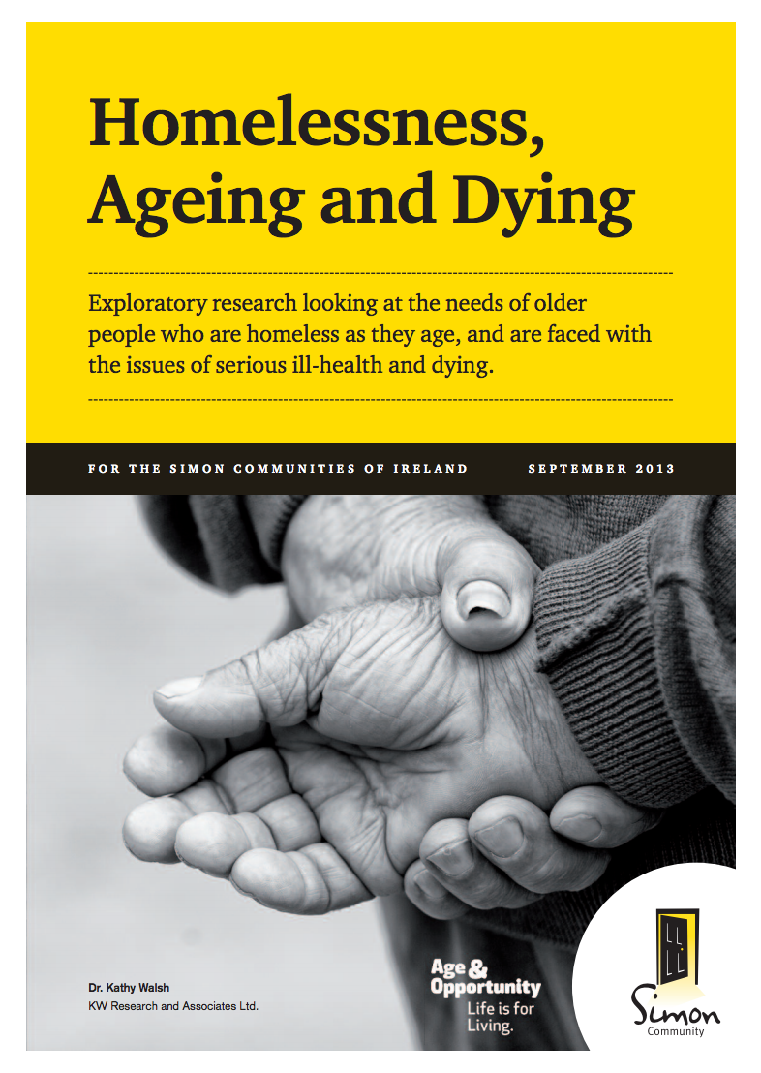
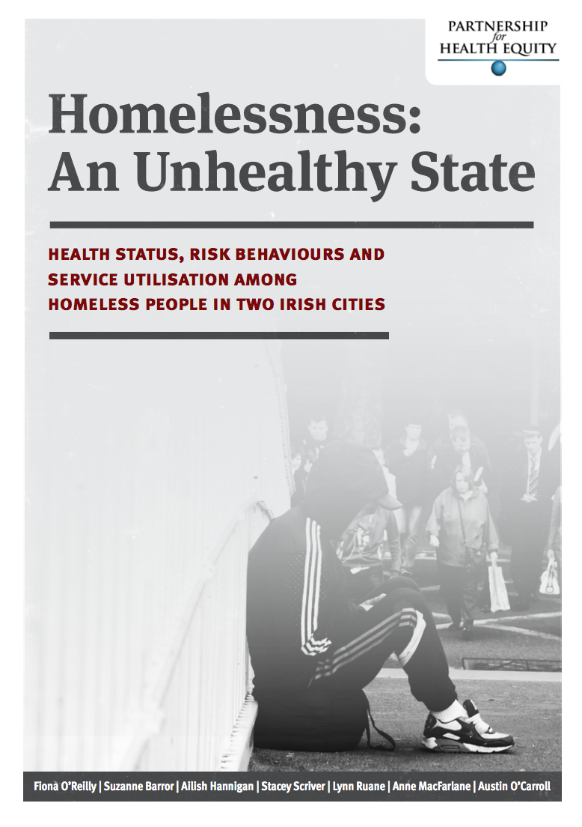
homeless people and health
Notes:
We know homeless people have bad health. We know homeless people do not engage with health services in a ‘normal’ way. Fiona O’Reilly, Austin O’Carroll and many others have completed phenomenal work demonstrating this. This is consistent with international research.

Slide 10
Homelessness, life limiting illness and dying
DEATH
Expected
Unexpected
Photograph: The Irish Times 14/7/15
Notes:
So we move onto death death in people who are homeless. My simplified way of looking at death in people who are homeless is by categorising death into 2 major groups – unexpected deaths; such as overdoses, a bad pneumonia, or something sudden, and expected deaths from a disease that could be a ‘predictable death’. A little bit simplistic if we are to be pedantic about it, but I will use this categorisation for today’s purposes.
Jo-Hanna Ivers from Trinity presented her work at this symposium last year, capturing cause and place of death where possible from 2005 – 2015 of homeless people in DHRE services. Because of the nature of homelessness and medical records, there are gaps in the data, but it is the best data that we have to date
What this showed was the majority of people died from sudden unexpected deaths, but that there is a small percentage of homeless people who die from “life limiting illnesses’. This is likely to become more of an issue with the aging homeless.

Slide 11
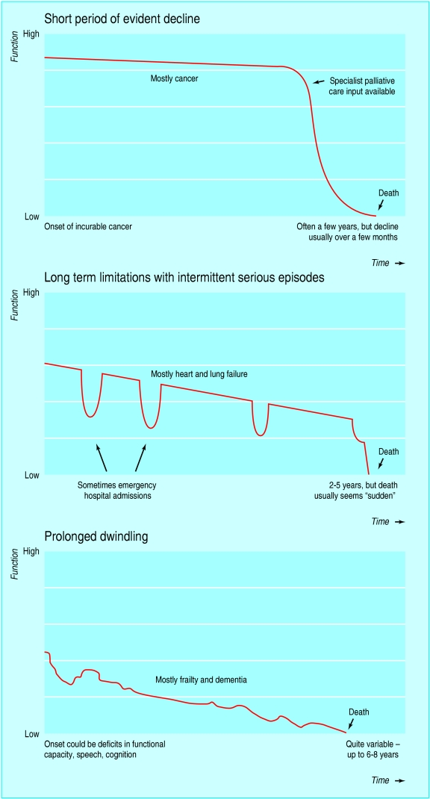
The problem with dying is that it’s difficult to predict
DEFINE: ”a life limiting condition”
Examples of disease trajectories
- warning: this are not exactly how it happens; especially in non cancer disease
Lynn J, Adamson DM. Living well at the end of life. Adapting health care to serious chronic illness in old age. Washington: Rand Health, 200
Notes:
And it is it is this small group of people who may benefit from palliative care services
We have discussed the term ‘life limiting illness’ - illnesses where it is expected that death will be a direct consequence of the specified illness.
How to you predict death?
Tough question
These are examples of disease trajectories that are often used and presented. I have to warn you that these are not an exact science and are a guide only.
What we see here if level of function on the Y axis, and time on the X axis.
With cancer people can often function quite well, then there is a relatively rapid change and death can occur within what is considered a short time
With chronic disease – so lets say COPD in a long term heavy smoker, you get dips where someone may look very unwell, but with medical attention they may improved to their previous functional level or just below. But at any of these dips they are at risk of dying and it is sometimes hard to predict if they will or not.

Slide 12
Research
Notes:
There is growing body of evidence looking at end of life care for homeless peope. This is paper published this year in Palliative Medicine, and it was a large study in London that aimed to explore the challenges to access and provision of palliative care.
They interviewed staff in homeless services, former homeless people and current homeless people.
Some of their key findings were that -
There is a large emotional, and practical burden on hostel staff in supporting homeless people with advanced ill health
There is a conflict between the recovery-focused nature of many service and the realities of health and illness for homeless people
There is need for collaboration between health, housing and social services
There is a need for training and support for professionals and those working with homeless people as their health deteriorates

Slide 13
What have we been doing?
Trying to quantify problem
Review of work to date
Not us! TCD study on mortality – Dr Ivers, Prof Barry
’promoting ourselves’
Workshop at ISMS16
Presentation ISMS17
Research
Collaborative work…
Qualitative study
Attempted national review – unable to complete
Retrospective case series from one organsiation
Presented at ISMS15 – Andrew Hudson
HOPEFULLY LOTS!
Notes:
We have tried to quantify how many homeless people die from “predictable” deaths – this has been very difficult and we have been unable to quantify this from our data. As previously mentioned the work performed by Dr Ivers and Prof Barry is the best data we have available on this so far. Their work is awaiting publication.
We have tried to promote ourselves here and in other forums, to begin conversations about death and to work with services
I am conducting a qualitative study – I have interviewed staff working in homeless accommodation in Dublin to explore their experience of death of a service user – this work will be presented and published in 2018 hopefully
We are aiming to have more collaborative work such as education sessions between services.

Slide 14
Patient factors
Place of care
Increasing care needs
Staff factors
(bio)logical family
Uncertainty around prognosis
lack of family support
Addiction
Mental health issues
Poor engagement with health services
Expectation to replace nurses/carers?
Medication handling
Duty of care to other service users
Notes:
When we look at end of life care for a homeless person and the provision of care for that individual we can think about patient factors that will influence care such as
- Place of care
- Increasing care needs
- lack of family support
- Addiction
- Mental health issues
- Poor engagement with health services
We can also look at the staff factors in the accommodation where that individual is living - What is emerging from the interviews that I have conducted so far is that
- there is a sense of wanting to facilitate death in that accommodation if that place is considered a ‘home’ for the service user
- concern that hospitals think homeless accommodation is staffed by nurses
- staff would like guidance around prognosis
- there can be issues around medication handling
- concern that if a lot of staff time is needed to facilitate death of one service user – that they must also be cognizant of other service users and their needs and staff time they need

Slide 15
Thank you aoibheann.nichonfhaola@gmail.com
Notes:
That very brief review of our services and work we are doing
I would be very happy to take questions or to be emailed

