Slide 1
Irish Street Medicine Symposium 2017
An integrated approach: The health response to homeless health care needs
29th September 2018
Joe Doyle
www.hsesocialinclusion.ie

Slide 2
Presentation
Social Inclusion and where it sits in the HSE
Data/ Evidence re Health Care Needs from a social inclusion perspective
Service Perspective re Need
Way Forward
Leavers to achieve integration
Current Activity/ Future Need

Slide 3
About Social Inclusion in the HSE
Located in Primary Care Division.
Key aim is to enhance access of vulnerable groups to health services…equality of access, participation and outcomes....
Remit includes: Addiction, Homelessness, Intercultural Health (Asylum seekers, Refugees, Migrants), Traveller and Roma health, Domestic, Sexual and Gender based Violence, LGBT, Community Development etc…
Involvement in aspects of Hepatitis C, Prison health, HIV/AIDS, Survivors of Institutional abuse, Trafficking, Sex Offender programmes etc…
Budget of €133.3mil - 0.96% of €13.9bil health budget/ - 13.1% of Primary Care Budget €1bil (National Service Plan 2017).
Approximately 650 employees - 0.62% of 105,000 HSE/ 6.25% of Primary Care 10,400.
Majority of service delivered via SLA under Section 39 (@70:30).

Slide 4
Service Priorities and Commitments
Nationally identified and agreed within the HSE Service and Operational Planning processes.
Agreed and aligned with the CHOs.

Slide 5
Governance
Feeding into the Primary Care Management Team a National Social Inclusion Governance Group (SIGG) makes sure that appropriate arrangements are in place to coordinate, support and monitor best practice of all our services.
Various working groups report to the National Social Inclusion Governance Group. These include the:
National Addiction Advisory Governance group;
Homeless Advisory Governance group;
National Intercultural Health Governance group; and
National Traveller Health Advisory Forum.

Slide 6
Homelessness
Represent the views of the HSE on the Rebuilding Ireland – Pillar 1 Project Team.
Following Minister Murphy announcement a homeless interagency group is to be established:
  Ensure delivery in a coherent way between all players
  Ensure transparency from the various Depts. and Agencies.
  Oversee coordination including Health (via CYA, HSE Tulsa) purpose to increase health supports.

Slide 7
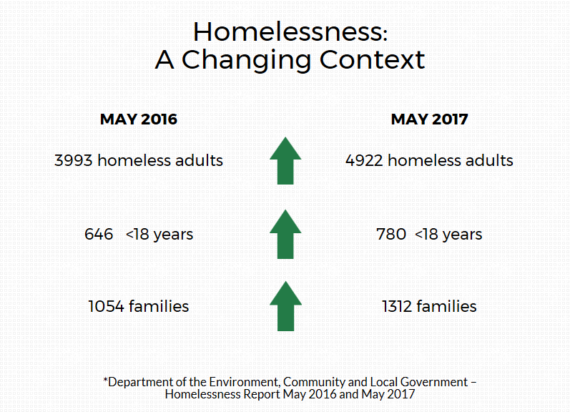

Slide 8

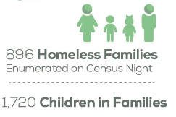

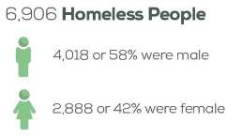
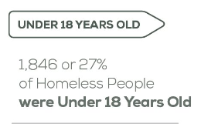
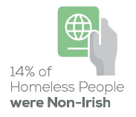

Slide 9
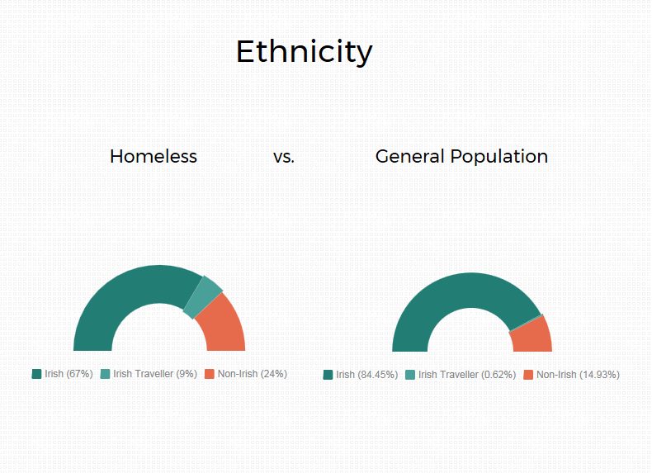

Slide 10


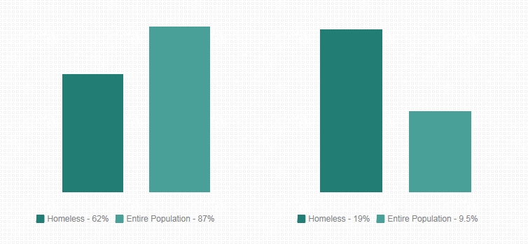
General Health
Homeless vs. Entire Population
“Very good or good”
“Fair, bad or very bad”

Slide 11
Disability
27% (homeless) vs. 13.5% (entire population)
Most common types of disability:
Difficulty with pain, breathing, chronic illness (12.2%)
Psychological or emotional condition (11.9%)
Difficulty learning, remembering or concentrating (9%)
Difficulty with working or attending school/college (9%)

Slide 12
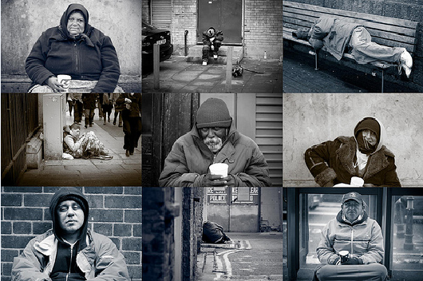
Illicit Drug or Alcohol use
~78%
Mental health diagnosis
~60%
Physical ill-health ~81%
TRI-MORBIDITY
OF HOMELESS PERSONS
Dual diagnosis
(The Partnership for
Health Equity, 2015)
Barriers to accessing healthcare
Unscheduled emergency care

Slide 13
HIV Outbreak 2015
Total number of confirmed or probable cases was 39
Median age was 35 years (36 years in males and 34 years in females)
74% (n=29) were co-infected with Hepatitis C
59% (n=23) were male and 41% (n=16) were female
56% (n=22)} reported risky sexual practices (sex with a PWID, sex with a known
positive partner or sex with a known positive PWID partner)
41% (n=16) reported snow blow use (38% of females and 44% of males)
74% (n=29) were registered homeless (94% of females and 61% of males)
Three cases were reported to have died – all 3 died within a month of their diagnosis.

Slide 14
HIV Outbreak 2015
Outbreak occurred in a very vulnerable group of homeless chaotic PWID.
The use of a new psychoactive substance (NPS) snowblow was a catalyst that led to an increased risk of HIV infection
likely due to changes in the harm reduction strategies and sexual behaviours in this population.
http://www.eurosurveillance.org/ViewArticle.aspx?ArticleId=21274

Slide 15
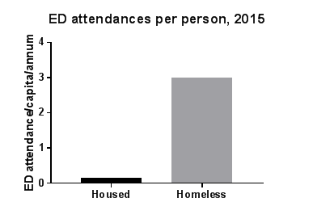
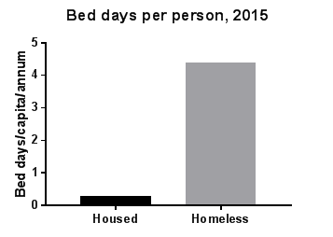
Health service access
-Increased access to primary care services (GP access and medical card)
-Increased use of ED
-Need for strengthened liaison between primary care, secondary care services and ED to ensure appropriate service provision

Slide 16
Health Service Provider perspectives
Survey: The changing context of homelessness and health care provision ---HSE & Safetynet
Key findings:
‘Noticeable change in service context over the last few years’
‘More serious and complex presentations (Tri-morbidity ~50% of presentations)’
‘Lack of housing options and availability’
‘Not accessing health care they require’

Slide 17
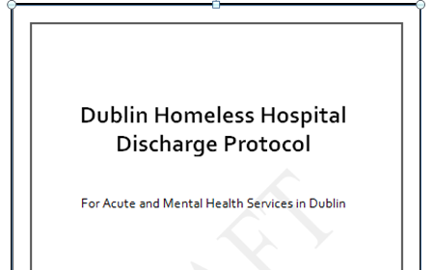
Key feedback
Lack of suitable accommodation
Lack of emergency accommodation for people with health needs
Unscheduled ED/inpatient admissions and delayed discharges
More staff needed (particularly SW in hospitals)
Need to establish local Healthlinks/Homeless Action Teams (HATs) to ensure continuity of care
Lack of routine standardised data collected on homelessness to inform resource allocation

Slide 18

The Way Forward

Slide 19
Degree of Fragmentation
Over 250 Community and Voluntary organisations in substance use (€22.5m) plus 50? @ €20m? in Homelessness
In the region of 30 Residential Tier 4 Services: 787 national residential rehabilitation, detox and step down (643 rehab, 144 detox).
Other statutory providers: Department of Justice, Irish Prison Service, Probation Service, Department of Education, Garda Síochana, Local Authorities, Department of Social Protection, Department of Children and Youth Affairs, etc…
24 Drug and alcohol Task Forces that coordinate services at local level, 9 Homeless Fora, LCDC’s etc….

Slide 20

Application of a cross-sectoral integrated care approach to Drug and Alcohol Services and Homeless Services – the experience from Southern Region

Slide 21













1 Region 2 Sectors 25 Agencies
75 Services

Slide 22

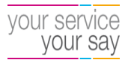




Levers to achieve integration within HSE
Service User involvement
Guidelines…Audit…..Frameworks/ Protocols
Commitments in HSE National Service and Operational plans, National KPIs
Service User Satisfaction Survey
HSE National Standards for Safer, Better Healthcare (HIQA, 2012)

Slide 23
Leavers to achieve integration externally
Strategies – Rebuilding Ireland/ National Drugs Strategy
Service Level Agreements
Competency Based Training
Gaps and Blocks process
‘Local Drivers’ supported through Peer Network

Slide 24

2017 key activities in Homelessness:-
Dublin Discharge Protocol
Competency Framework for Homeless and Addiction services
Dual diagnosis service
Greater Integration between Primary Care and Mental Health
Supervised injection facility
Rebuilding Ireland Funding Commitment - Funding priorities and objectives - (Housing First, Discharge Liaison, multidisciplinary teams/comprehensive services that address multiple needs).

Slide 25
2018 and beyond....
Cross-sectoral national strategy for health care provision for homeless persons - prioritising integrated and person orientated ways of working
National Homeless Health Group
Implementation and review of discharge protocols across all areas
Implementation of Competency Framework for Homeless and Addiction services
Funding priorities /objectives
... research, standardised data collection, capacity building…
To Be Continued………!

Slide 26
What’s needed?
Response to complex, multiple vulnerabilities
Response to new presentations in changing context
Integrated, system-wide approach
Person-orientated services
Service-user involvement
Training, support and knowledge for staff working in the sector
Intersectionality in policy, research and service-delivery
Rights based approach, creativity in research and practice, shifting cultural paradigms

Slide 27
WHO Framework on Integrated, people-centered health services
“all people have equal access to quality health services that are co-produced in a way that meets their life course needs, are coordinated across the continuum of care, and are comprehensive, safe, effective, timely, efficient and acceptable; and all carers are motivated, skilled and operate in a supportive environment”

Slide 28

Thank You
Contact Details: joseph.doyle@hse.ie

