Slide 1
Mobile Health Clinic

Slide 2
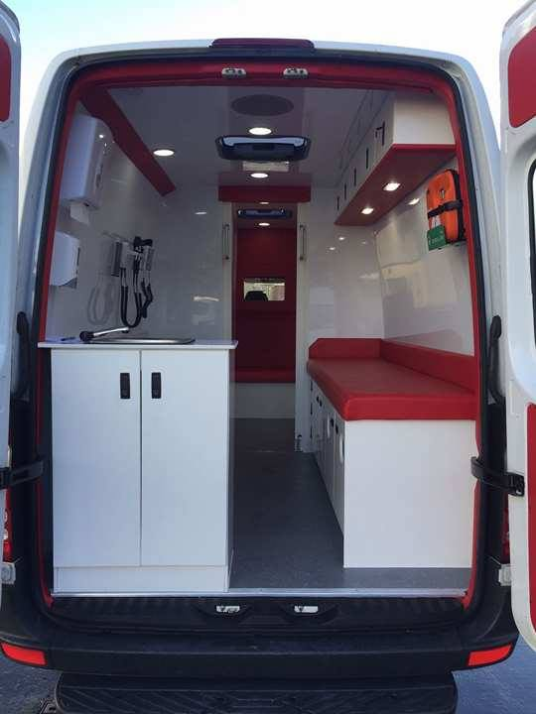
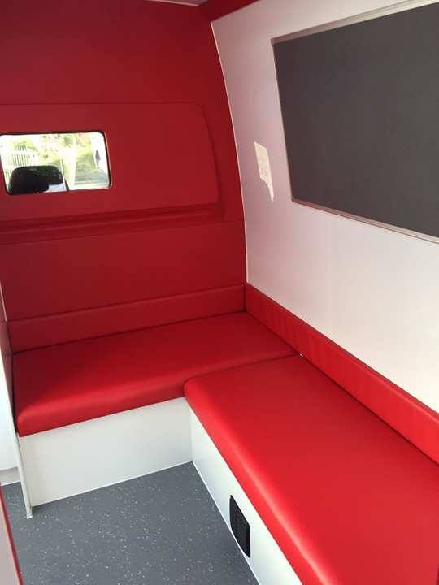
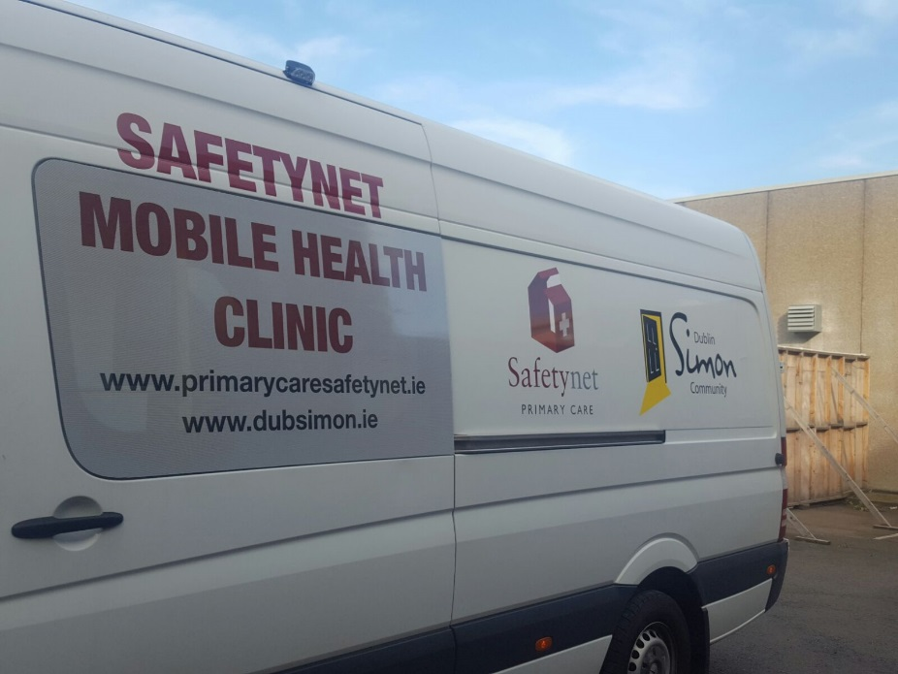
The vehicle

Slide 3
Purpose
To bring health care to homeless individuals who are rough sleeping or have no access to health care.
To link clients presenting to the ‘bus’ into medical and homeless support services
To provide harm reduction and needle exchange services
To provide GP registrars with experience working with a homeless client and increase their understanding of the needs of that group.

Slide 4
Operations
Referral to MHU
RST
Other voluntary and statutory services who have contact with rough sleepers
Engagement
Health Care Provision
Referral on and follow up
HF Intake
Harm Reduction
Holistic Needs Assessment
Building therapeutic relationships
Assertive follow up by Nurse and RST
Secondary Care (SJH, MMUH, SVUH)
Primary care services (GP, In-Reach, GMQ, Capuchin)
Treatment Services
Emergency accommodation
Members of the public

Slide 5
Team
GP Registrars- NDCGP, UCD, TCD
Safetynet Nurses
Safetynet Clinical Supervisors
Dublin Simon Community- Rough Sleeper Team
Order of Malta
Notes:
40yr old lady sleeping in tent in Chaplelizod with aggressive partner. Seen form 2011-2016 by MQI, Haven, Granby and MHU – Diabetes, Respiratory tract Infections. Alcohol dependence.
In 2016 seen in Bru and Granby post inpatient stay in Hospital including ICU. Last seen Oct 2016
In July 2017 referred by RST to MHU – visited in tent in Chaplelizod. Very unwell, no diabetic meds for last 6 months. Over next month In Reach and MHU see her 12 times. MHU get a bed in Bru for the odd night, blood samples taken on MHU, BSL 31, admitted to SJH for inpatient stay x 1 week. Stabilised and discharged back to tent. MHU continues to link in for prescribing of medications. Linked in with Diabetic clinic in Capuchin Centre.

Slide 6
Case Study 1
40yr old female
Sleeping in tent in Dublin 20
Medical History - Diabetes, Respiratory tract Infections, Alcohol dependence.
Referred by HF Intake in July 2017
Visited in tent by medical team
Very unwell, no diabetic medicines for 6 months, bloods taken on MHU, admitted to hospital via Inclusion health team (SJH)
Stabilised and discharged back to tent with support from MHU.
Regular visits by MHU to prescribde medication, promote compliance and do general health checks.
Remains stable and is linked in with Diabetic clinic at the Capuchin
Notes:
40yr old lady sleeping in tent in Chaplelizod with aggressive partner. Seen form 2011-2016 by MQI, Haven, Granby and MHU – Diabetes, Respiratory tract Infections. Alcohol dependence.
In 2016 seen in Bru and Granby post inpatient stay in Hospital including ICU. Last seen Oct 2016
In July 2017 referred by RST to MHU – visited in tent in Chaplelizod. Very unwell, no diabetic meds for last 6 months. Over next month In Reach and MHU see her 12 times. MHU get a bed in Bru for the odd night, blood samples taken on MHU, BSL 31, admitted to SJH for inpatient stay x 1 week. Stabilised and discharged back to tent. MHU continues to link in for prescribing of medications. Linked in with Diabetic clinic in Capuchin Centre.

Slide 7
Case Study 2
70yr old female, drove from Mainland Europe.
Sleeping in a car in Dublin 9 carpark.
Medical History - Diabetes, spinal stenosis, foot drop
Member of public referred to Dublin Simon team. MHU attended
Took Bed in Bru night shelter. Where to park car !
Stayed in Bru Aimsir x 2 weeks
Multiple interventions for personal care and supports provided by HSE Healthlink. Attempts made to secure suitable private rented accommodation as had pension. Unsuccessful.
Left Dublin and moved on – still in contact by phone
Notes:
70yr old lady sleeping in her car with Cat in Santry. Drove from Germany. Very poor mobility issues uses Zimmer frame & Diabetes.
McDonalds staff reported her to RST team. MHU attended Nurse convinced to take Bed in Bru night shelter. Followed MHU back to Bru in her car. Where to park car a problem as shes afraid belonging will be robbed. Temporary solution found. Focus Housing First team took lead in arranging taxis for her to and from her car during the day.
Stayed in Bru x 2 weeks. Multiple interventions for personal care and supports. Attempts made to secure suitable private rented accommodation as had pension. Unsuccessful.
Left Dublin and moved to Cork.

Slide 8
Case Study 3
55 yr old male
Left hostel accommodation as felt unsafe.
Rough sleeping on beach
Referred by RST
Medical History - Alcohol dependence , foot fracture ?osteomyelitis, PVD
Self-Discharged from SJH. Multiple DNA’s
Weekly visits by MHU – trust building, wound care, harm reduction
Accompanied to fracture clinic, tent taken away while at appointment
Admitted to Dublin Simon Detox Unit
Notes:
55yr old male - new patient to Safetynet referred from Focus Ireland Intake team. Left hostel accommodation as felt unsafe. Staying on Killiney beach when first visit. Drinking 10 cans/ day, smoker, no other drug use.
Self-Discharged from SJH. Admitted from ED. Fracture / Osteomyelitis. Now ulcers on R foot after using orthopaedic boot. DNA multiple appointments
MHU team have attended a few times, dressed foot, referred to detox.
Attended fracture clinic, tent taken away while at appointment
Admitted to simon detox 3 days later and doing well

Slide 9
Acknowledgements
Dormant Account Fund- Purchase of new vehicle
HSE Social Inclusion
Dublin based GP Training Programmes (UCD, TCD, NDCGP)

