Slide 1
“Which side of the street?” A discussion of the complexities of involuntary admissions in the homeless setting.
Anna Marie Naughton AHIT
Jim Lane AHIT
Denise Cremin Cork Simon Outreach

Slide 2
AKA
“Doing the forms”

Slide 3
Should we do the forms?
Doing the forms.
Now what do we do with the forms?

Slide 9
Stage 1
An application for a recommendation for involuntary admission-forms 1 to 4,
the applicant must have observed the person not more than 48 hours before the date of the making of the application, section 9(4).
.

Slide 10
Stage 2
Recommendation -form 5
Examination of the person must be carried out by the RMP within 24 hours of receipt of the application, section 10(2).

Slide 11
Stage 3
A period of 24 hours is provided for, in the legislation for the person to be held in the approved centre for the purposes of examination in relation to the admission order.
The admission order can last for the duration of 21 days.
During this time the mental health commission will direct a consultant psychiatrist (section 17) to review, examine and complete a report to the mental health tribunal within 14 days.
The mental health commission organises a mental health tribunal to review the admission order, as soon as the Consultant Psychiatrist (section 17) completes his/her report for the
mental health tribunal.
Upon receipt of this report, the mental health tribunal must review the admission order within 21 days of its signing.

Slide 12
Stage 4
Not more than seven days before the expiry of the admission order/renewal order, the treating consultant psychiatrist in the approved centre will review and examine the patient.
Following this examination, and only if the admission order is made, the treating consultant psychiatrist will complete a renewal order for a period up to three months, six months or twelve months.
Within 21 days of the signing of each renewal order by the treating consultant psychiatrist, a MHT will convene
to affirm /revoke the Order. A review and report by the Consultant Psychiatrist (section 17) is
required by the mental health tribunal prior to each sitting.

Slide 13
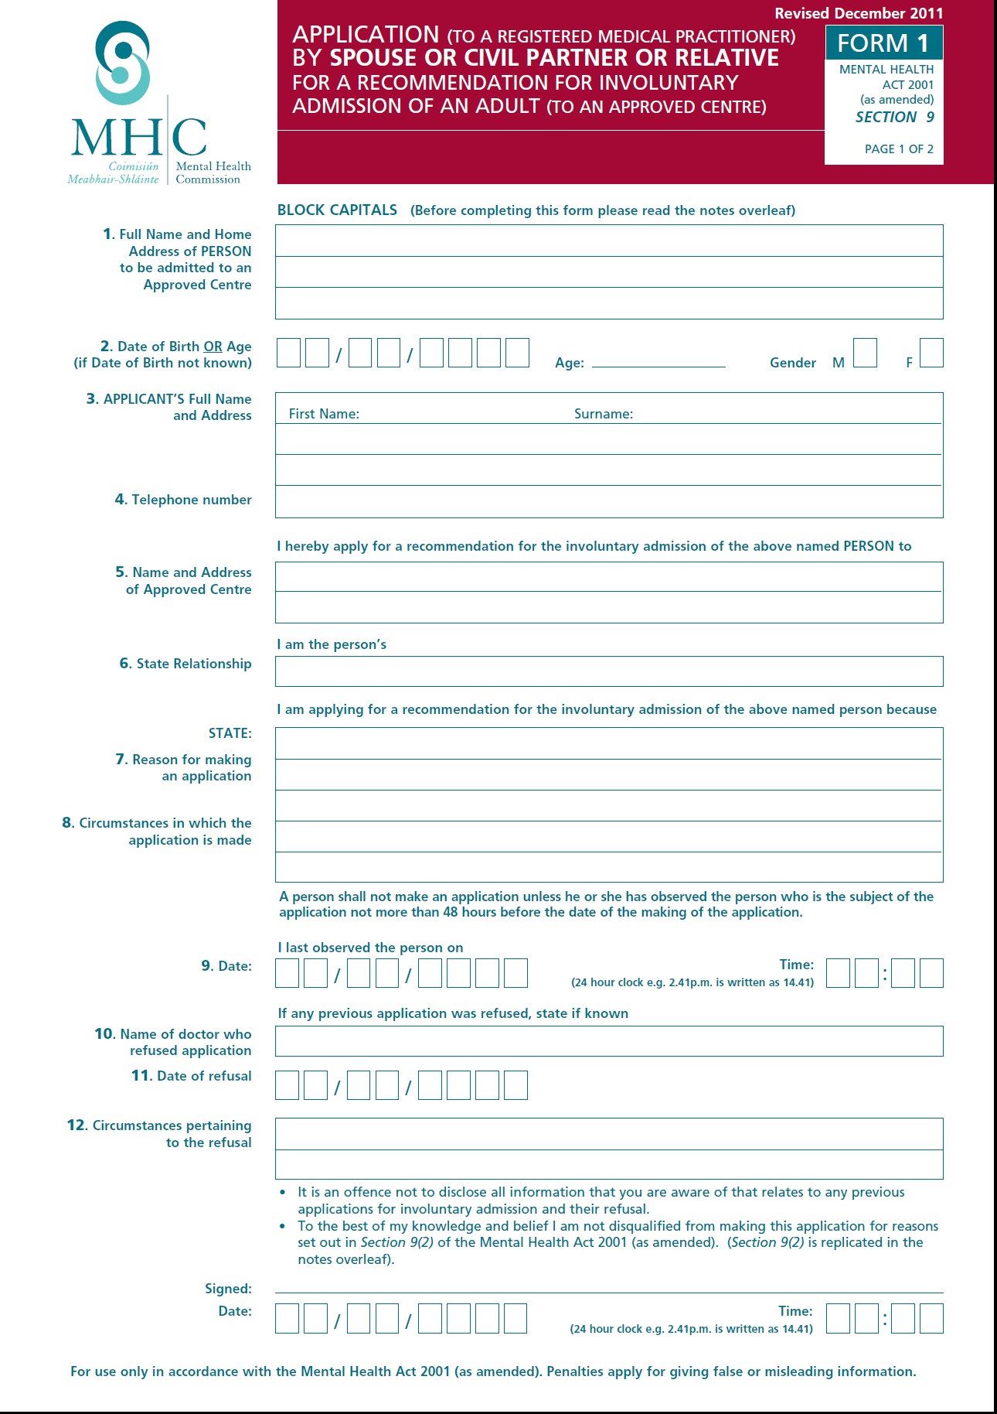

Slide 14
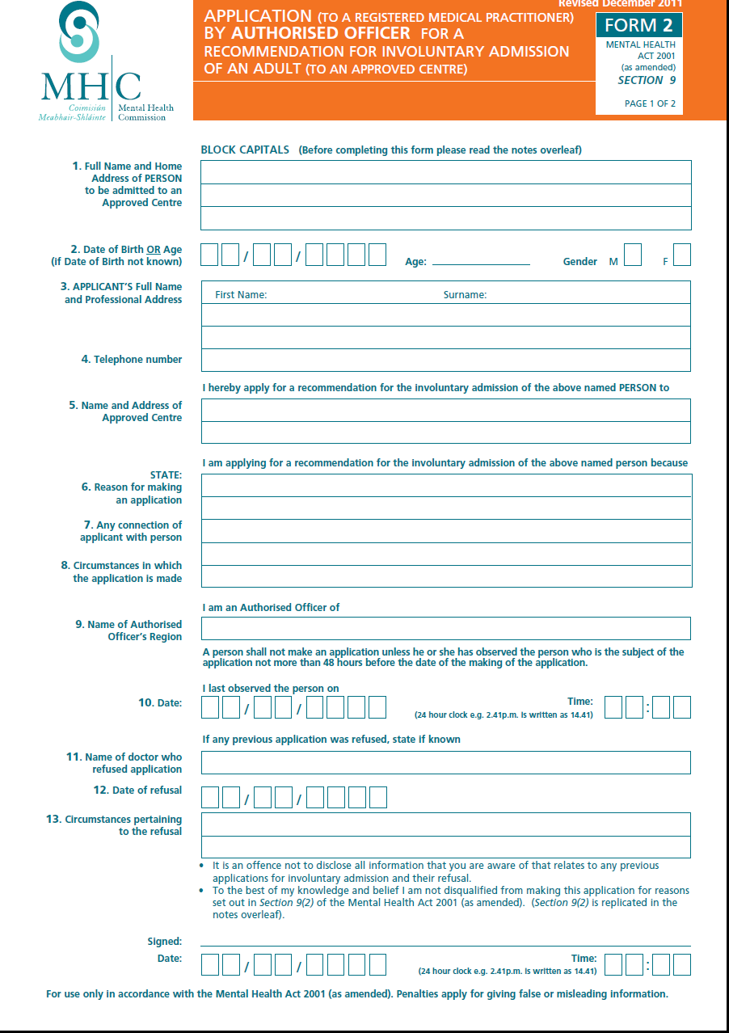

Slide 15
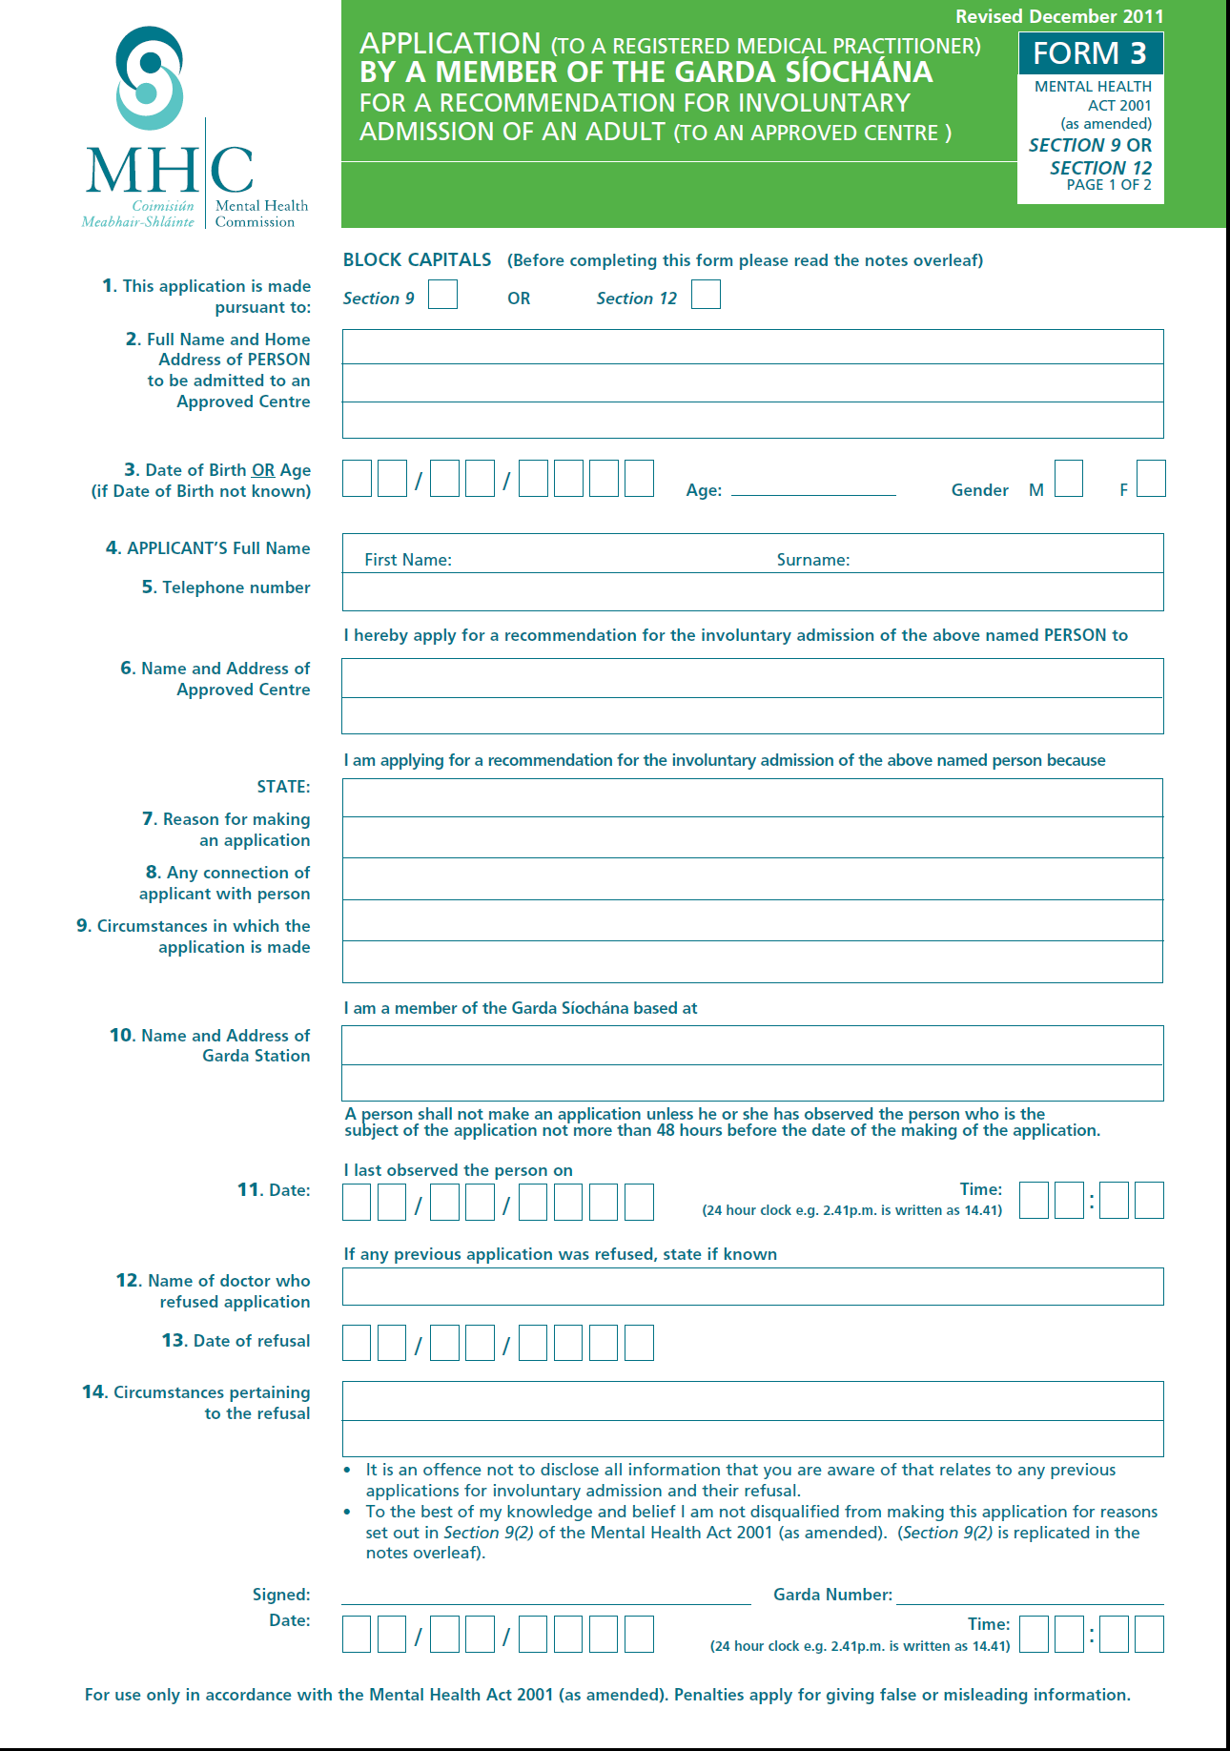

Slide 16
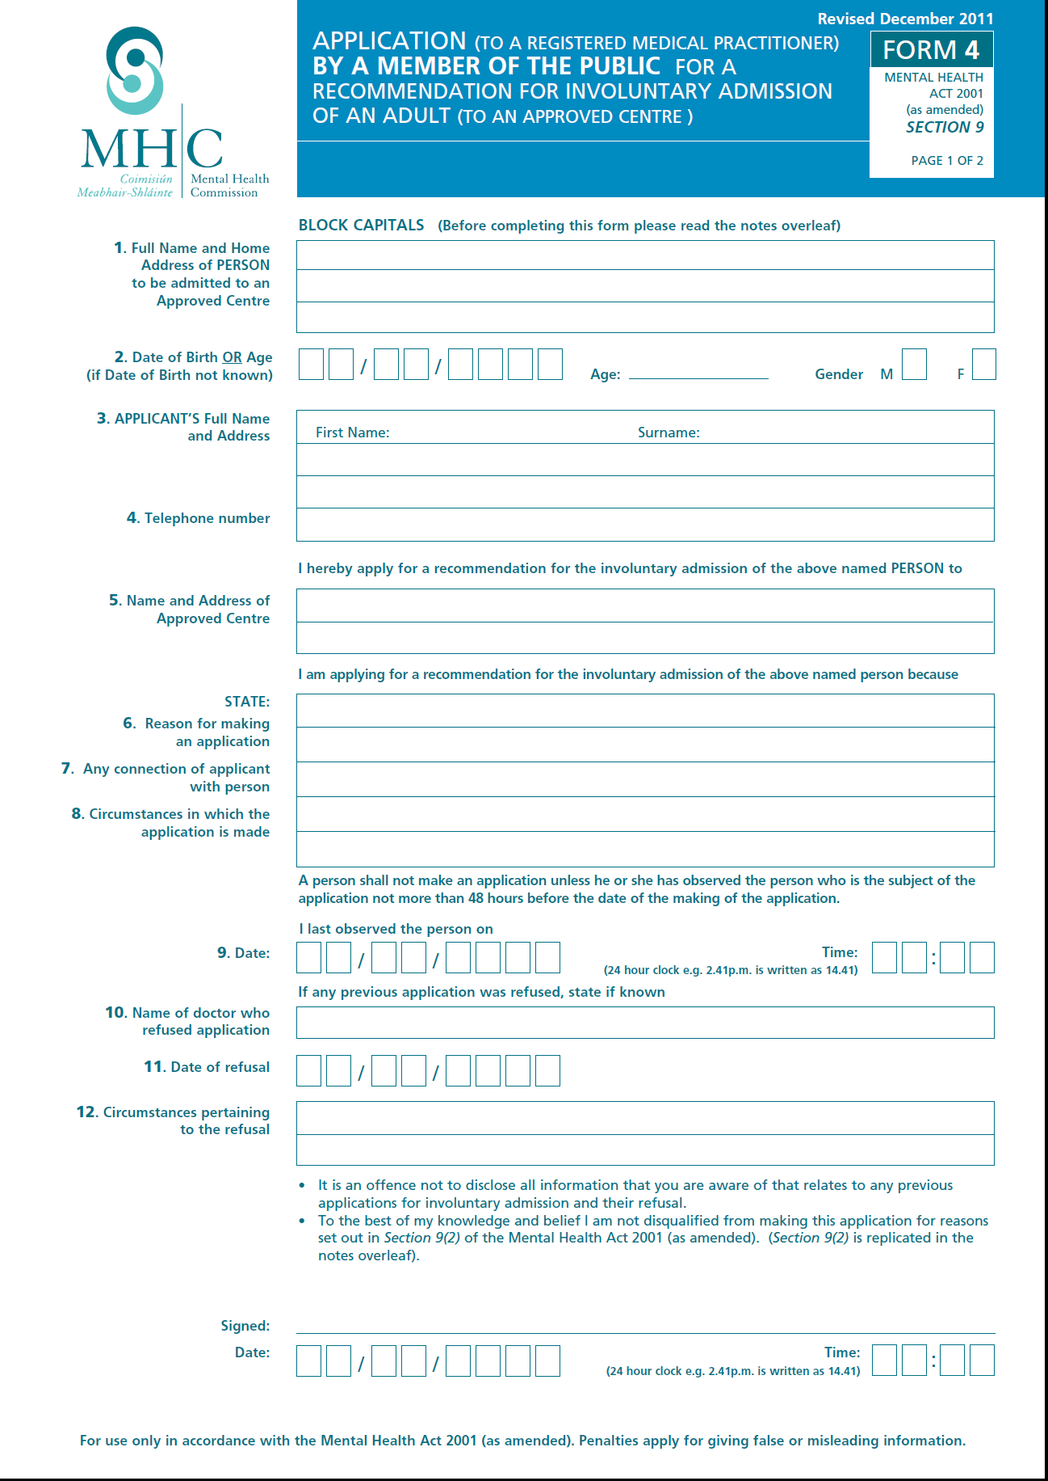

Slide 17
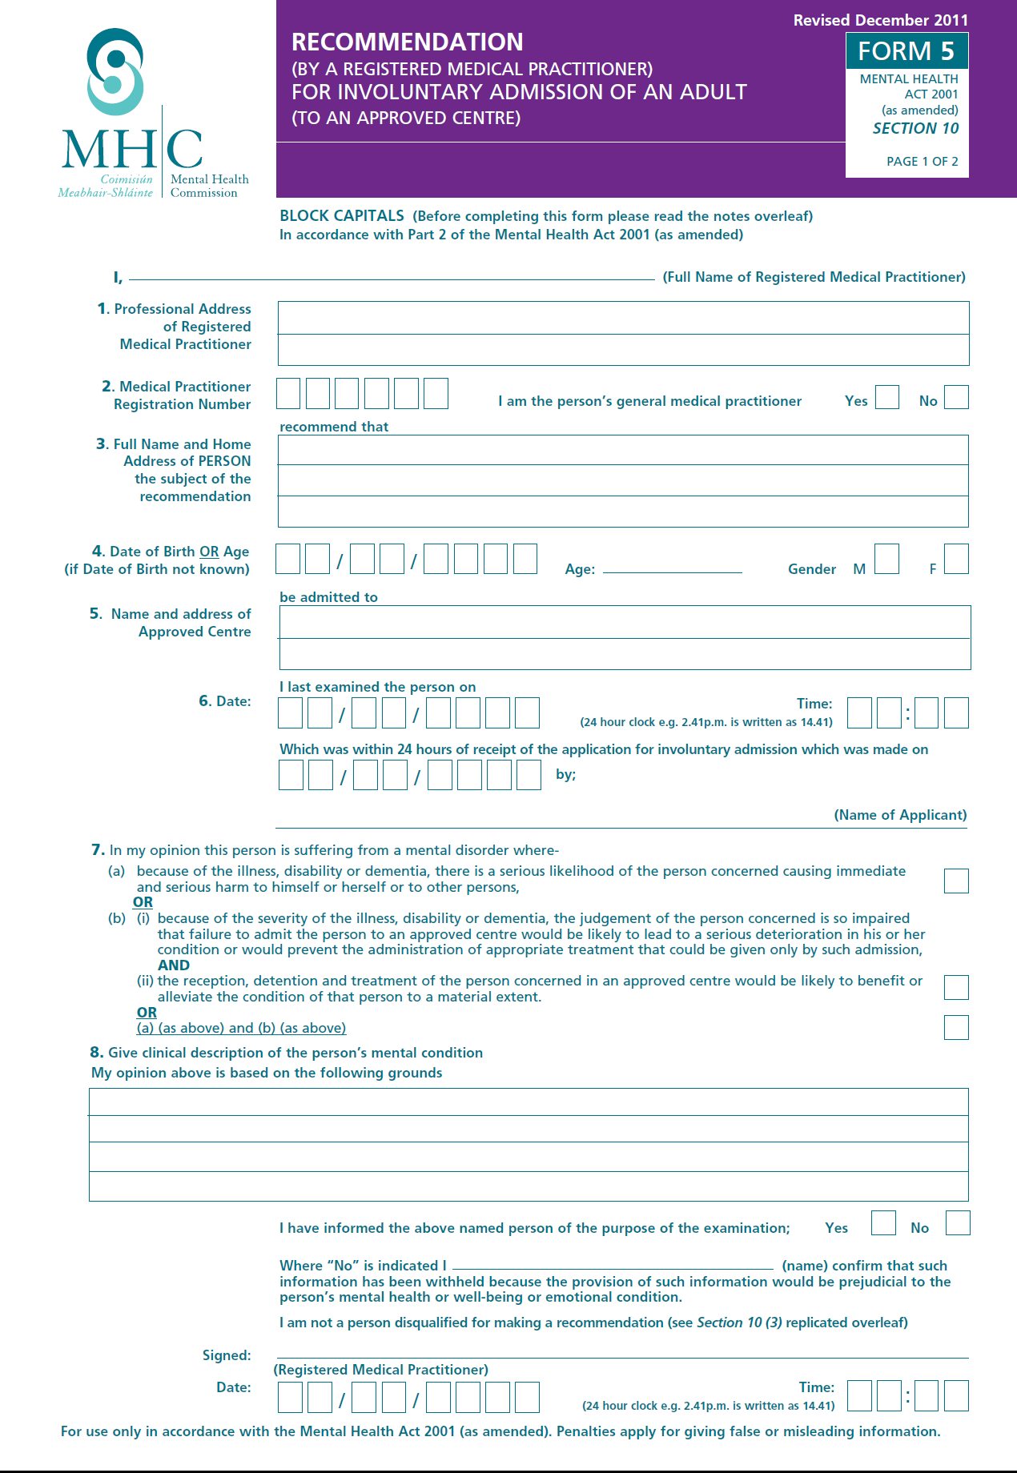

Slide 18
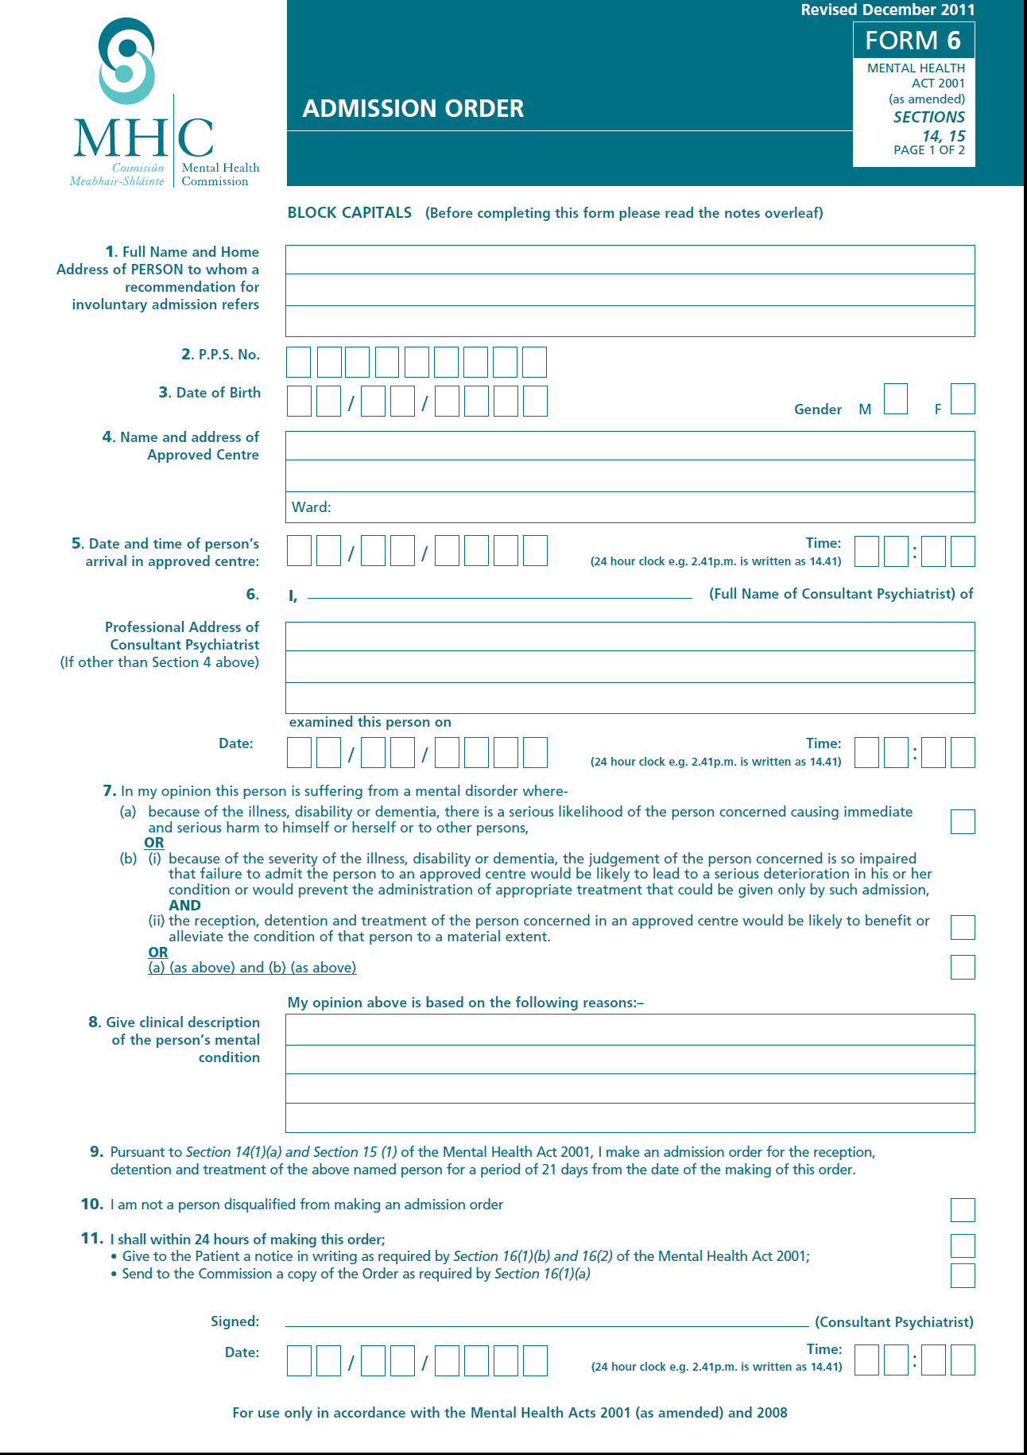

Slide 20
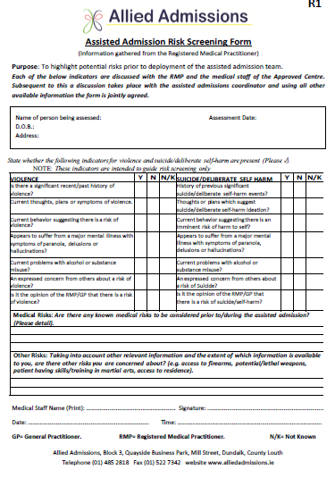
Getting there.

Slide 21
Allied Admissions
The team will be dispatched following a request by the Clinical Director /Consultant Psychiatrist of the Approved Centre.
In broad terms the process is as follows;
A basic risk assessment will be carried out by the Clinical Director/Consultant Psychiatrist in consultation with the Registered Medical Practitioner prior to the initiation of the assisted admission/return.
Where it is necessary, the Clinical Director/Consultant Psychiatrist may request that the Assisted Admissions team are assisted by An Garda Siochana, pursuant to s.13(3) Mental Health Act, 2001. The assisted admissions team will be fully briefed prior to deployment.
The team will present to the individuals address after receiving the forms as required by the Mental Health Act, 2001.
The team will meet with the applicant/ Authorised Officer and confirm the identity of the individual requiring the service.
An on-site risk assessment will be carried out by the Team Leader.
Every effort will be made by the team to encourage the co-operation of the individual in the admission.
The individual will then be transported to the Approved Centre for assessment.
The Admission procedure will include the handover of the care of the service user to the Mental Health Team at the Approved Centre.
Following the admission procedure, the team will stand down.
The Team Leader will complete a post assisted admissions debrief

Slide 22
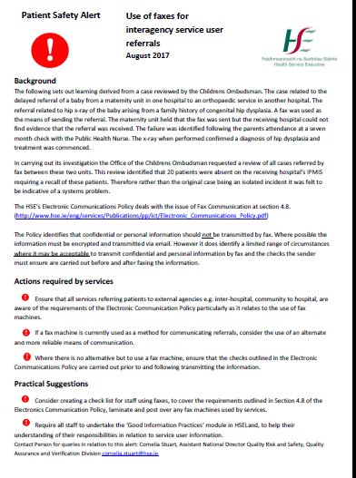

Slide 23
Electronic Communications Policy
Users must respect the privacy of others at all times and only access fax messages where they are the intended recipient or they have a valid HSE work-related reason.
Users who receive fax messages where they are not the intended recipient must contact the sender and notify them of their error and destroy or return the fax message as directed by the sender. •
Users need to consider whether a fax is the most appropriate means of communication.
Confidential and personal information should not be transmitted by fax.
Where possible the information must be encrypted and transmitted via email.

Slide 24
The fax message includes a HSE Fax Cover Sheet
2) The fax number of the intended recipient(s) is correct.
3) Only the minimum amount of confidential or restricted information as is necessary for a given function(s) to be carried out is included in the fax message;
4) Where practical telephone the intended recipient before the transmission to ensure they are waiting by the fax machine for the fax message;
5) When the fax mkeep a copy of the transmission slip and where practical contact the intended recipient to confirm receipt of the fax message.
6) Remove all documents from the fax machine immediately after faxing.

Slide 25
Where possible, fax machines which are used to send or receive confidential fax message’s should be physically secured and positioned in such a way as to minimise the risk of unauthorised individuals accessing the equipment or viewing any incoming messages.
Wherever possible the fax machine should be switched off outside of normal office hours.
Where possible, only fax machines which are owned or leased by the HSE should be used to send or receive confidential and restricted information.

