Slide 1
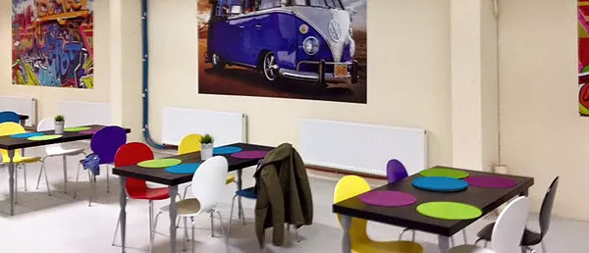
An Analysis of Mental Health Morbidity in Homeless Clinics
Dr Claire Dunne
Inreach Team GP

Slide 2
242 ‘mental health’ consultations
Addiction 81%
Non lethal suicide attempts 14
OVERDOSE
8 emergency department referrals

