Slide 1
“Put on your own oxygen mask first”
Dr Cathy Cullen
Dr. Cathy Cullen

Slide 2
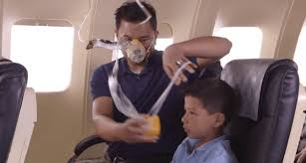
“Put on your own oxygen mask first”
Self care is a skill. It can be taught

Slide 3
Wholehearted Living
Love and belonging is life’s purpose
Believe you are worthy of it
Know it is a choice
A life defined by courage, compassion and connection
Willing to be vulnerable

Slide 4
Guideposts to wholehearted living

Slide 5
Cultivating authenticity
Letting go of “what people think”

Slide 6
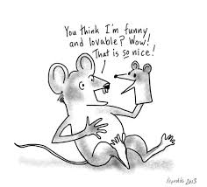
Cultivating self compassion
Letting go of perfectionism

Slide 7
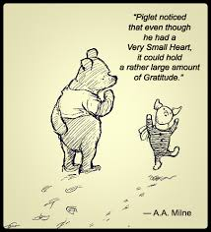
Cultivating gratitude and joy
Letting go of scarcity

Slide 8
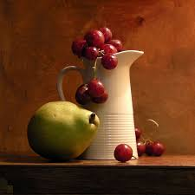
Cultivating calm and still
Letting go of anxiety as a lifestyle

Slide 9
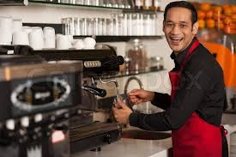
Cultivating meaningful work
Letting go of self doubt and supposed to

Slide 10
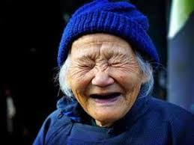
Cultivating Laughter, song and dance
Letting go of being cool and in control

Slide 11
Cultivating a resilient spirit
Letting go of “numbing”

Slide 12
Cultivating intuition and trusting faith
Letting go of need for certainty

Slide 13
Cultivating creativity
Letting go of comparison

Slide 14
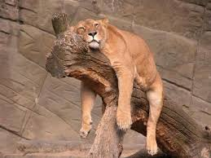
Cultivating play and rest
Letting go of exhaustion as a status symbol

Slide 15
Summary
Courage to be imperfect
Show Compassion to oneself
Connection because of your authenticity
Embrace vulnerability

Slide 16
Burnout
Lack of control
Value Conflict
Unfairness
Insufficient reward
Lack of community
Work overload

Slide 17
Authenticity What people think
Play and Rest Exhaustion/Productivity
Calm and Still Anxiety as a lifestyle
Resilient Spirit Numbing
Laughter, song and dance Being cool and in control
Self compassion Perfectionism
Intuition and trusting faith Need for certainty
Gratitude and Joy Scarcity
Meaningful work Supposed to/Self doubt
Creativity Comparison

